Slide 1

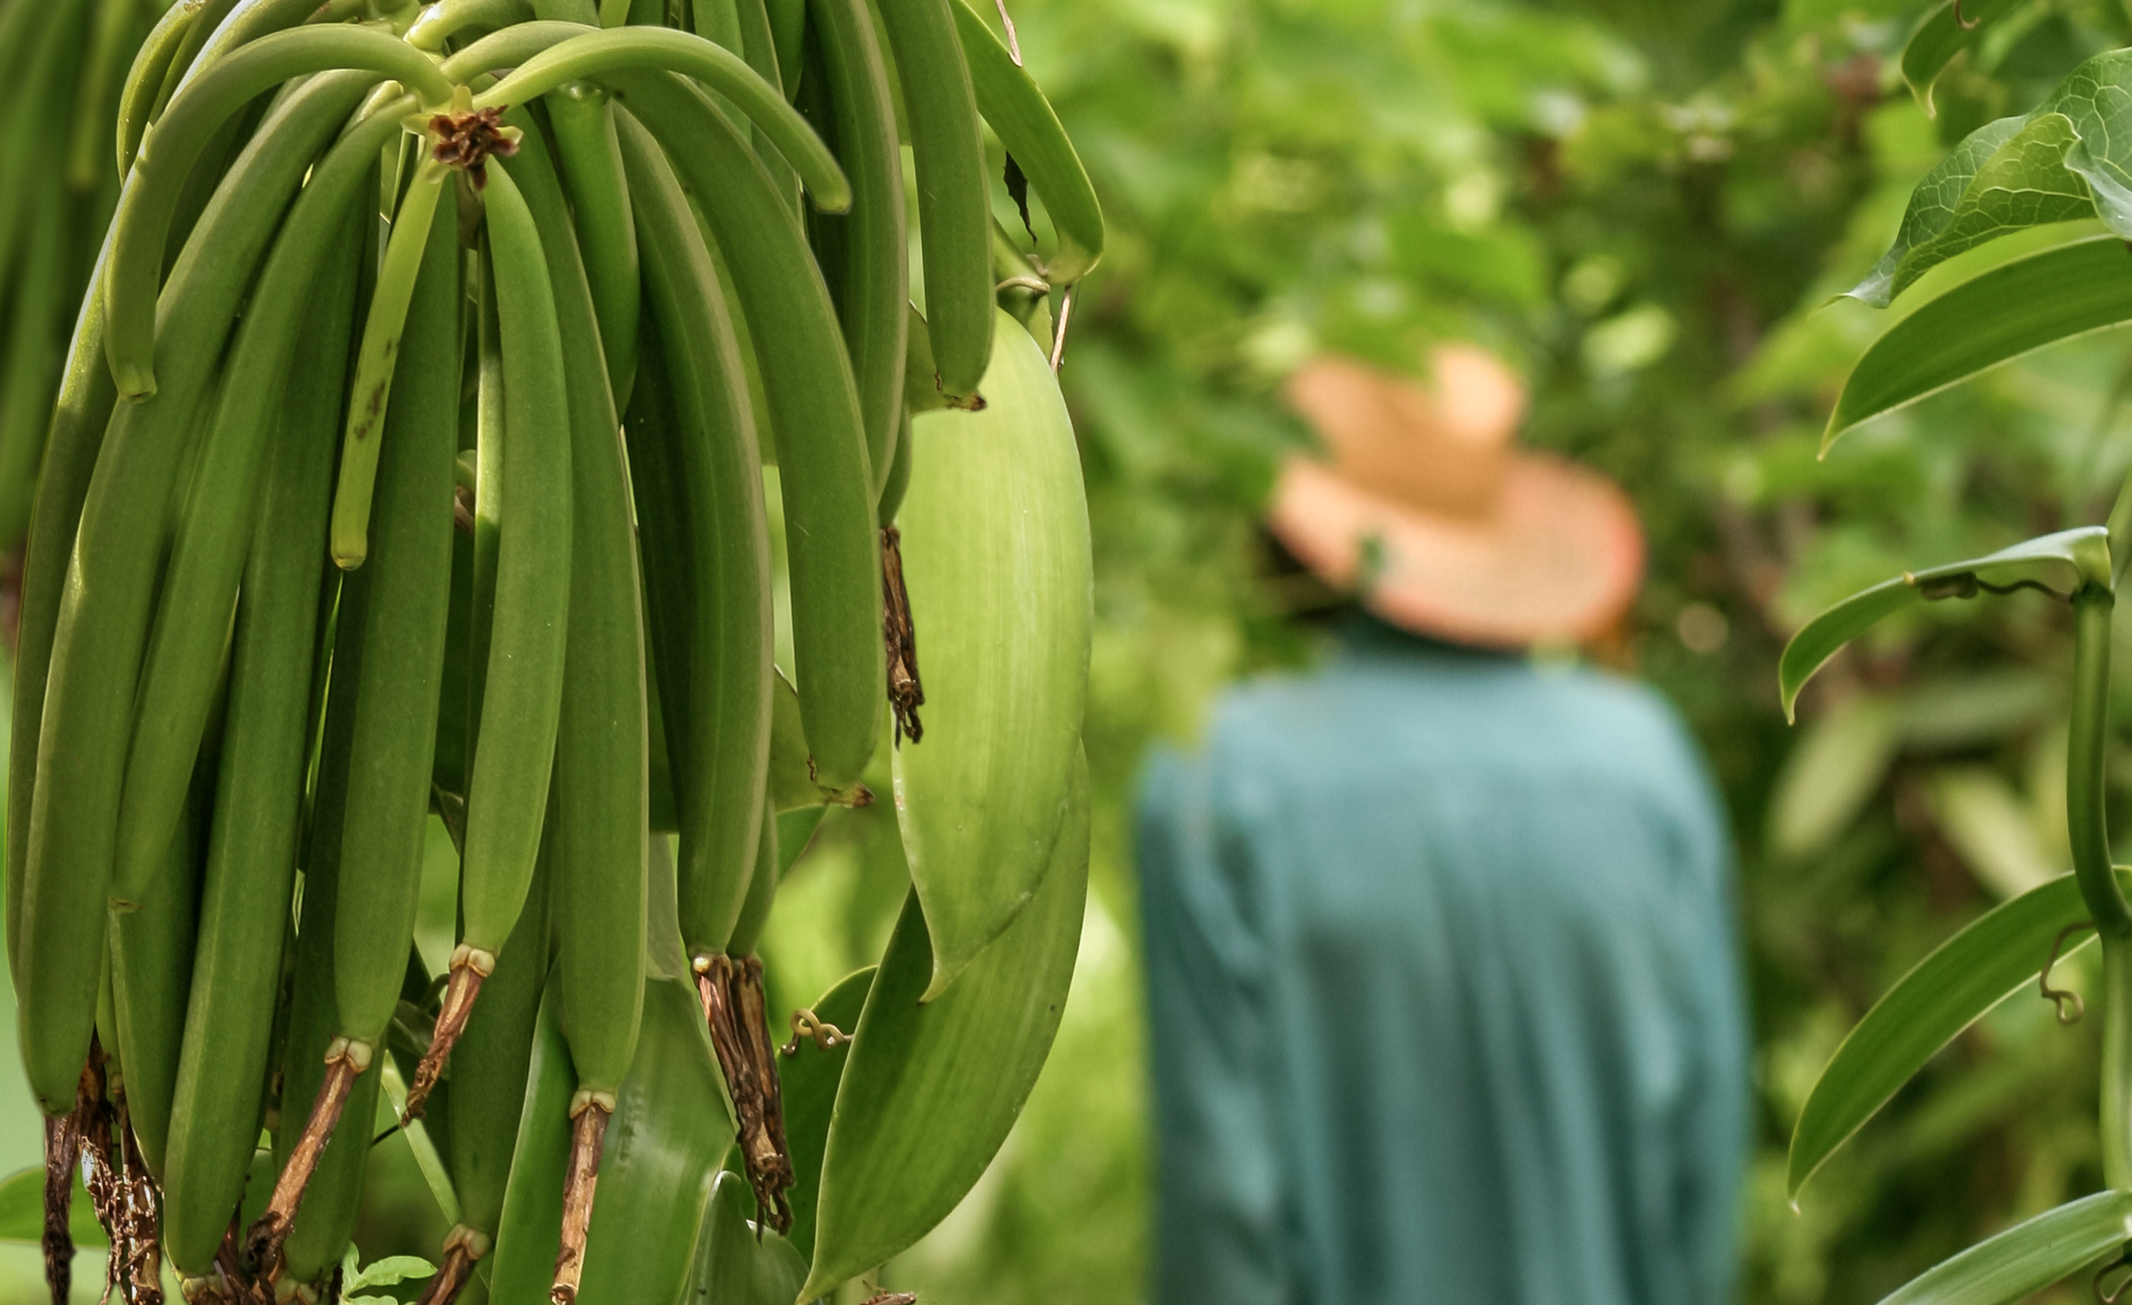
Living Income Toolkit
Make the Case for Adopting a Living Income

Slide 2
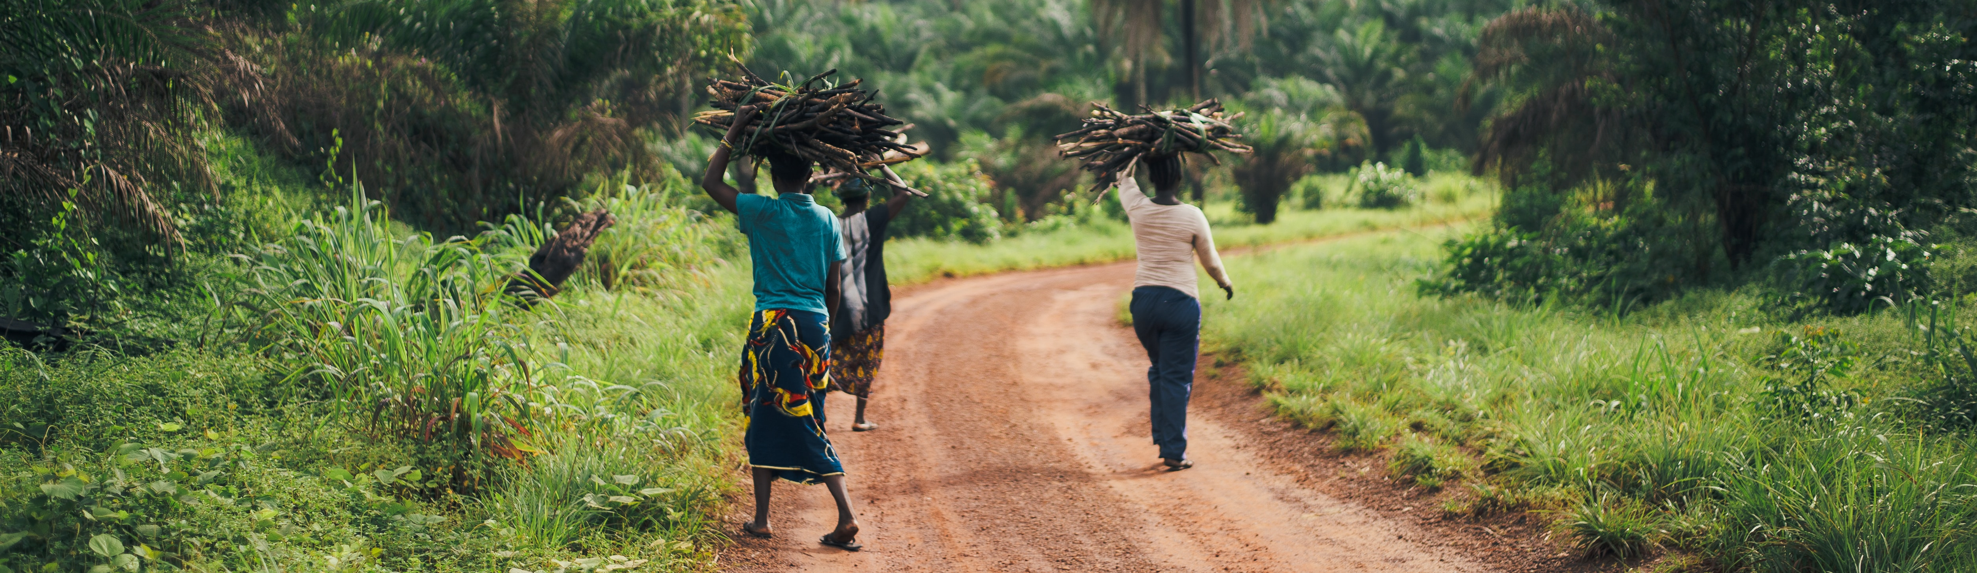
About this Toolkit
This Living Income Toolkit Slide Deck was designed as a support resources for companies developing the strategies on living income. Please feel free to use the deck for your own purposes, while maintaining the crediting included. All information is a supplement to the Toolkit Guiding steps towards living income in the supply chain: How to mainstream living income in your company’s activities.
The complete Toolkit PDF is available online here: https://c69aa8ac-6965-42b2-abb7-0f0b86c23d2e.filesusr.com/ugd/0c5ab3_8d2a4af1e03a43bbbea042551a19181f.pdf
Other slide deck ppt resources are forthcoming, and will follow the Toolkit Sections “Make the Case” and “Take action & Monitor Results”.

Slide 3
Table of Contents
Setting the Scene
Why a Living Income?
The Business Case
Human Rights
Reputation
Supply Security
Company Examples

Slide 4
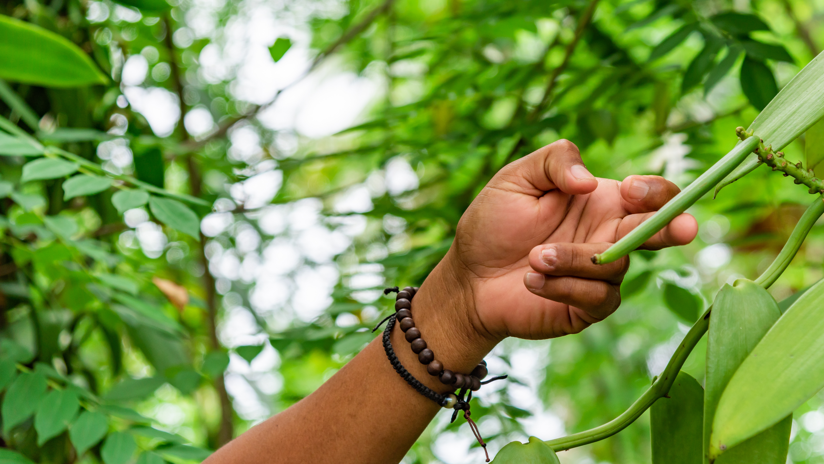
Setting
the Scene

Slide 5
The Living Income Concept
What is the Living Income Concept?
What does it mean to be able to afford a decent standard of living?
What does decency mean in this context?
The concept of a living Income focuses on the households’ ability to afford a decent standard of living
The net annual income of a household, which comes from a variety of sources, is sufficient to cover the cost of a decent standard of living for a typical household in a particular place.
Elements of a decent standard of living include access to food, water, housing, education, healthcare, transport, clothing, and other essential needs including provision for unexpected events.
Notes:
The concept of “living income” applies the concept of a living wage to a farming household and is defined as the net household income needed for a farming household to afford a minimum decent standard of living. Living income is not about meeting minimum or baseline levels of income. It emphasizes the need to be able to provide for a household to live comfortably.

Slide 6
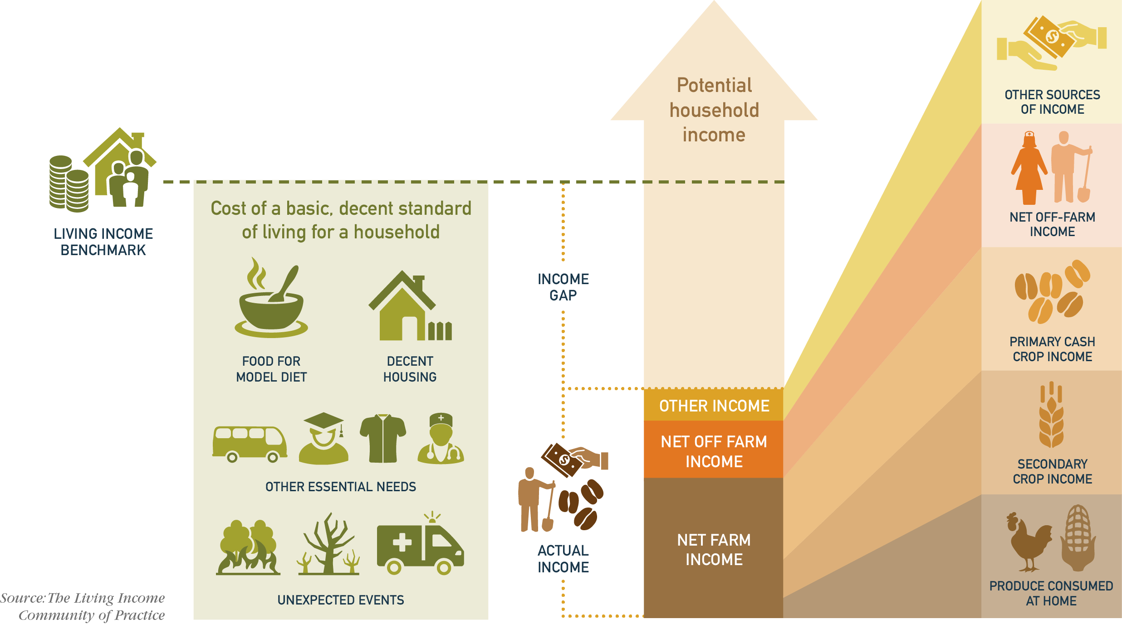
The Living Income Story
Notes:
The Living Income Story, as illustrated above, shows the basic building blocks of a living income.

Slide 7

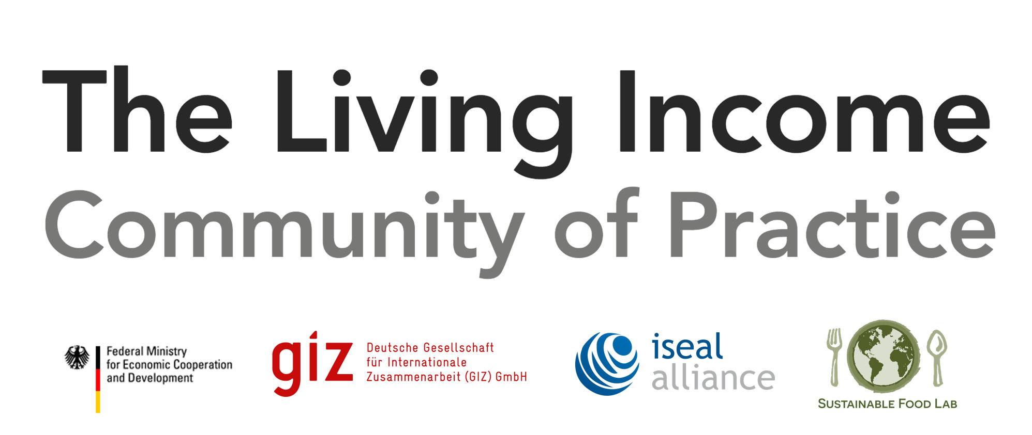
What is the difference between living income and living wage?
Both are derived from the idea of achieving a decent standard of living.
Living wage applies to an individual worker. Living income applies to a household.
Living Wage
A worker earns enough in a standard work week to enable his/her family to afford a decent standard of living.
Living Income
Farming households earn enough in a year from all income sources to afford a decent standard of living.
    https://www.globallivingwage.org
www.living-income.com
Notes:
Living wage is focused on a A worker earning enough in a standard work week to enable his/her family to afford a decent standard of living.
Living Income focuses on Farming households earning enough in a year from all income sources to afford a decent standard of living.

Slide 8
The CoP was created to further explore and develop this concept and to support activities focused on improving smallholder incomes towards living incomes, aiming to enable smallholder farmers to achieve a decent standard of living. This community is a result of a partnership between The Sustainable Food Lab, GIZ and the ISEAL Alliance.
​The objectives of this Community of Practice are to:
  Increase understanding of living income measurement and the income gap
  ​Identify and discuss strategies for closing the income gap"
www.living-income.com
Notes:
Learn more about Living Income Community of Practice and why you should adopt a living income strategy.

Slide 9

The Global Living Wage Coalition provides high quality and consistent knowledge and information about living wage levels, implementation, and impact necessary for stakeholders of all types to collaborate in a non-competitive environment toward wage increases globally.
In partnership with Fairtrade International, GoodWeave International, the Rainforest Alliance, and Social Accountability International (SAI), the ISEAL Alliance and international living wage experts Dr. Richard Anker and Ms. Martha Anker, the GLWC has a shared mission to see continuous improvements in workers’ wages in the farms, factories, and supply chains participating in their respective certification systems and beyond, and with the long term goal for workers to be paid a living wage. Each living wage benchmark commissioned by the GLWC is made public to further this aim and to increase the opportunity for collaboration toward payment of a living wage.
    www.globallivingwage.org
Notes:
Learn more about the Living Wage Coalition and how you can get involved to provide a living wage to workers.

Slide 10
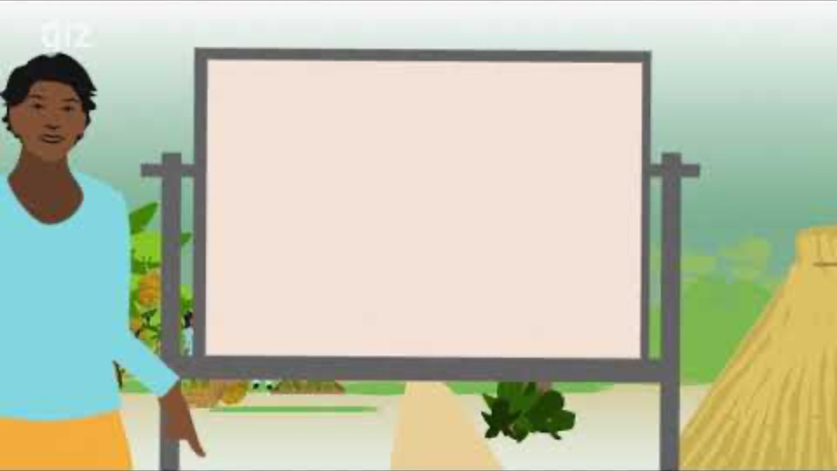
Living Income Video: https://www.youtube.com/watch?v=f3pVHryU8t8&feature=emb_logo
Notes:
Living Income Video: https://www.youtube.com/watch?v=f3pVHryU8t8&feature=emb_logo

Slide 11
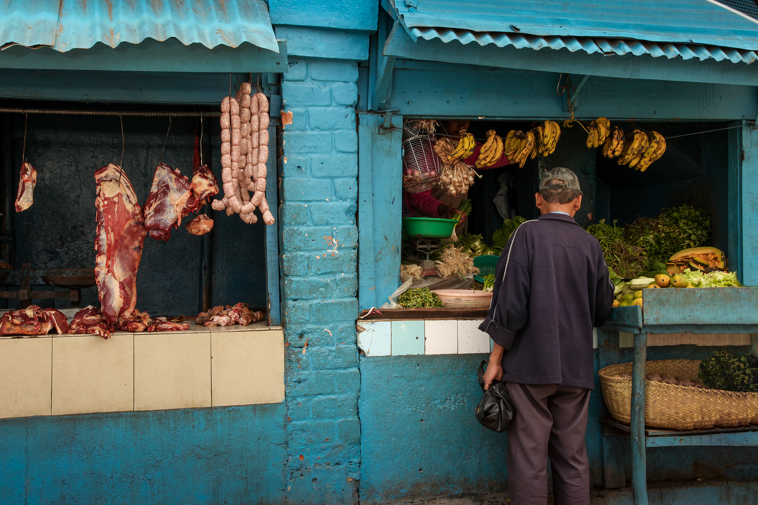
Why a
Living Income

Slide 12


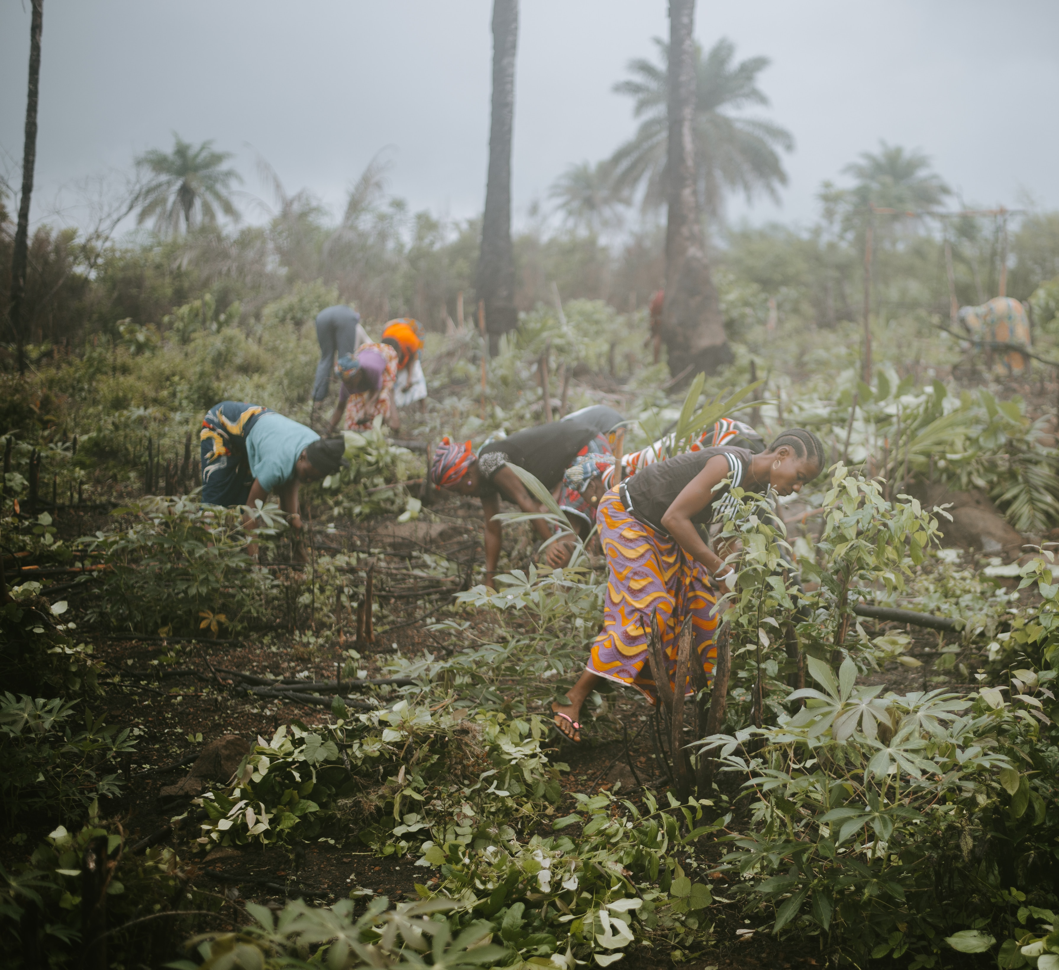


Globally, many smallholder farmers struggle with persistent poverty
There are approximately 500 million smallholder farmers (85% of the world’s total). They produce crops like coffee, cocoa, tea and barley. Selling through formal and informal markets and often living in developing areas of Africa, Asia and Latin America.
Notes:
Why now? The spotlight on this topic is increasing, especially for consumer-facing brands and the increasing number of companies that are committed to being fully ethical. Understanding on this topic is increasing, with more information available, numerous initiatives and strategies to draw learning from, and concrete steps laid out for organizations to take action.
The World Bank. A Year in the Lives of Smallholder Farmers. 2016. https://www.worldbank.org/en/news/feature/2016/02/25/a-year-in-the-lives-of-smallholder-farming-families

Slide 13




Farmers are struggling to make a living income
Coffee in Colombia
Cocoa in
Cote D'Ivoire
$707 Actual
Small Archetype (farmers on
1.3 ha) Making up 70% of Colombian Coffee Producers
$4467-5356 LI Benchmark
4-Person Household
$2352 Actual
Typical Male-Headed
Household
(< 4ha cocoa)
$6516 LI Benchmark
Male-Headed Typical
(3.5 children, 3.5 adults)
$3760-$4650 Gap
$4164 Gap
Source: Task Force for Coffee Living Income (TCLI) 2018
Source: Living Income Report Rural Côte d’Ivoire Cocoa Growing Areas
Notes:
Global companies commonly buy significant amounts of crops from smallholder farmers in Africa, Asia and Latin America; they may source either directly from smallholders or indirectly, through levels of suppliers. For example, 80% of coffee produced comes from 25 million smallholder farmers, while cocoa is produced by 6 million smallholder farmers who make up 90% of the total production worldwide.
Coffee in Colombia: https://c69aa8ac-6965-42b2-abb7-0f0b86c23d2e.filesusr.com/ugd/0c5ab3_f404e304ff8c47f1a56c791207406532.pdf
Cocoa in Cote d’iviore: https://c69aa8ac-6965-42b2-abb7-0f0b86c23d2e.filesusr.com/ugd/0c5ab3_a437a776dc7747c2999d3b0c60a46a97.pdf

Slide 14

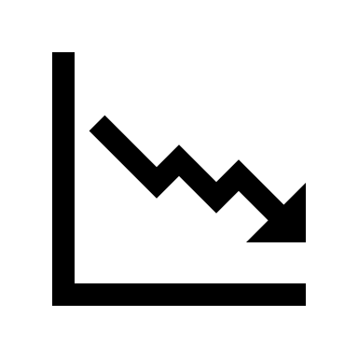










Major cash crops produced by smallholder farmers don’t provide adequate income in part because of:
  Unpredictable Weather
  Price fluctuation
  Lack of Information
  Lack of Technology
  No Social Net
  Inability to Organize
  Lack of Alternative Work
  Lack of Knowledge Sharing
  Lack of Investment
Low Productivity
Low & Volatile Prices
Small Land Parcels
Made worse by

Slide 15
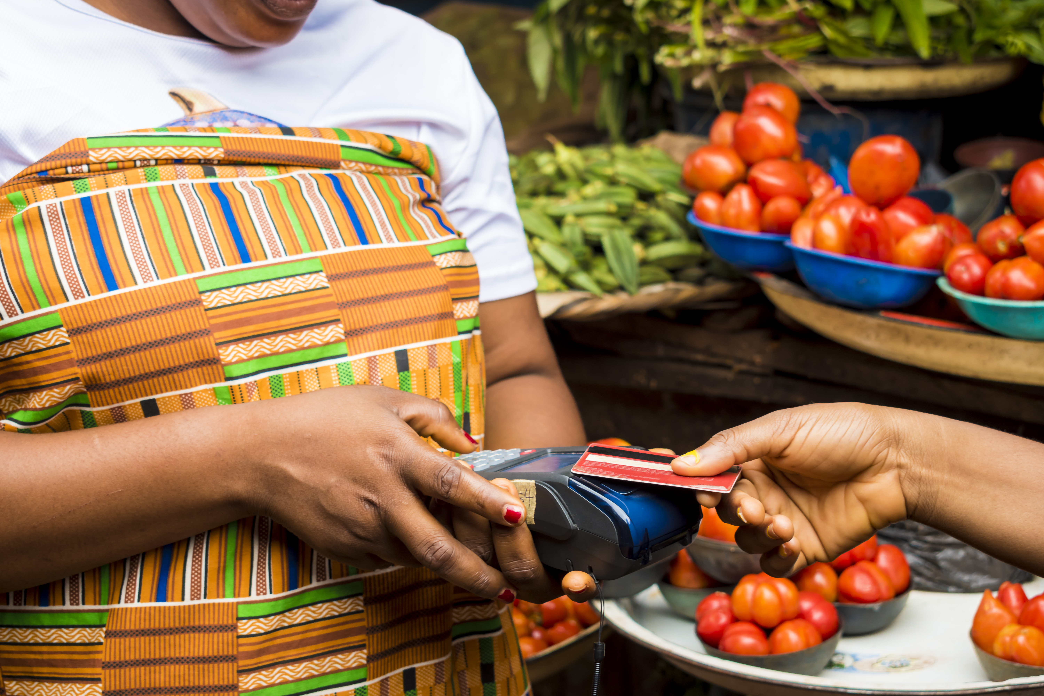
The Business
Case

Slide 16


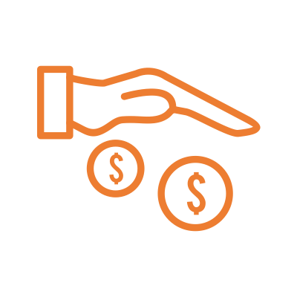
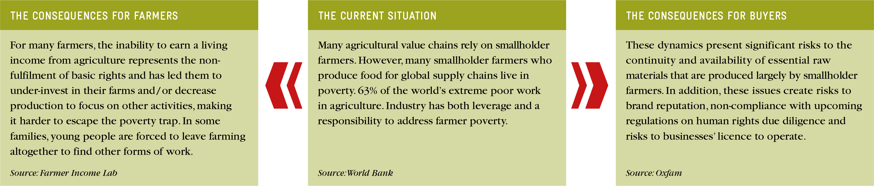
Inability of farmers to reach a living income presents significant risks for companies in addition to the significant negative impact on livelihoods it has for farming families
Notes:
https://www.farmerincomelab.com/sites/g/files/jydpyr621/files/2019-09/What%20Works_FINAL_9.19.pdf
http://documents.worldbank.org/curated/en/311511468326955970/pdf/818010BRI0EP120Box0379844B00PUBLIC0.pdf
https://policy-practice.oxfam.org.uk/publications/a-living-income-for-small-scale-farmers-tackling-unequal-risks-and-market-power-620596

Slide 17
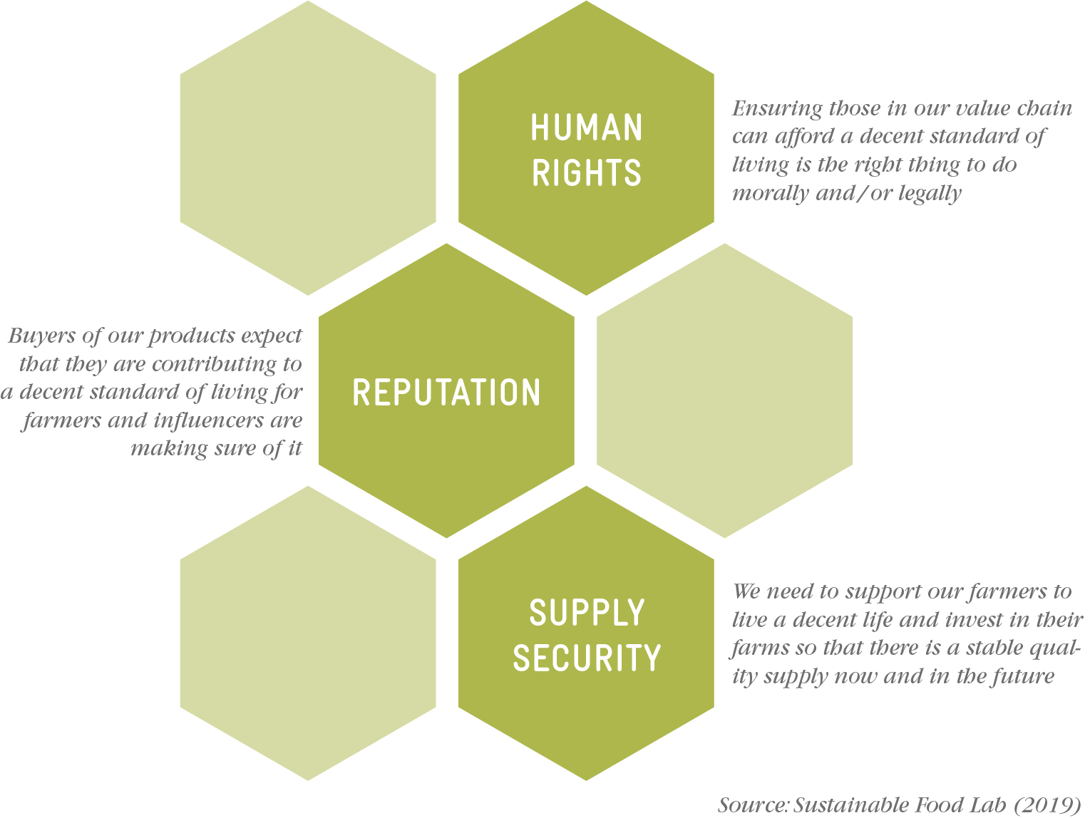
Three reasons why companies prioritize Living Income in farming communities

Slide 18
Human Rights
HUMAN RIGHTS
A decent standard of living is a human right and we are accountable for our producer partners.
The United Nations Universal Declaration of Human Rights recognizes that a decent standard of living is a human right.
  “Everyone has the right to a standard of living adequate for the health and well-being of himself and of his family, including food, clothing, housing and medical care and necessary social services, and the right to security in the event of unemployment, sickness, disability, widowhood, old age or other lack of livelihood in circumstances beyond his control.”
  -Universal Declaration of Human Rights, Article 25
The UN Protect, Respect and Remedy Framework, introduced by Dr. John Ruggie, and more recently the UN Guiding Principles on Business and Human Rights link human rights with company accountability for their actions. When companies employ people as hourly or salaried workers, this responsibility is generally adhered to through a company or government led minimum wage or, more ambitiously, a “living wage”. When it comes to independent producers and a wage is no longer appropriate, other methods must be used, such as a “living income”.

Slide 19
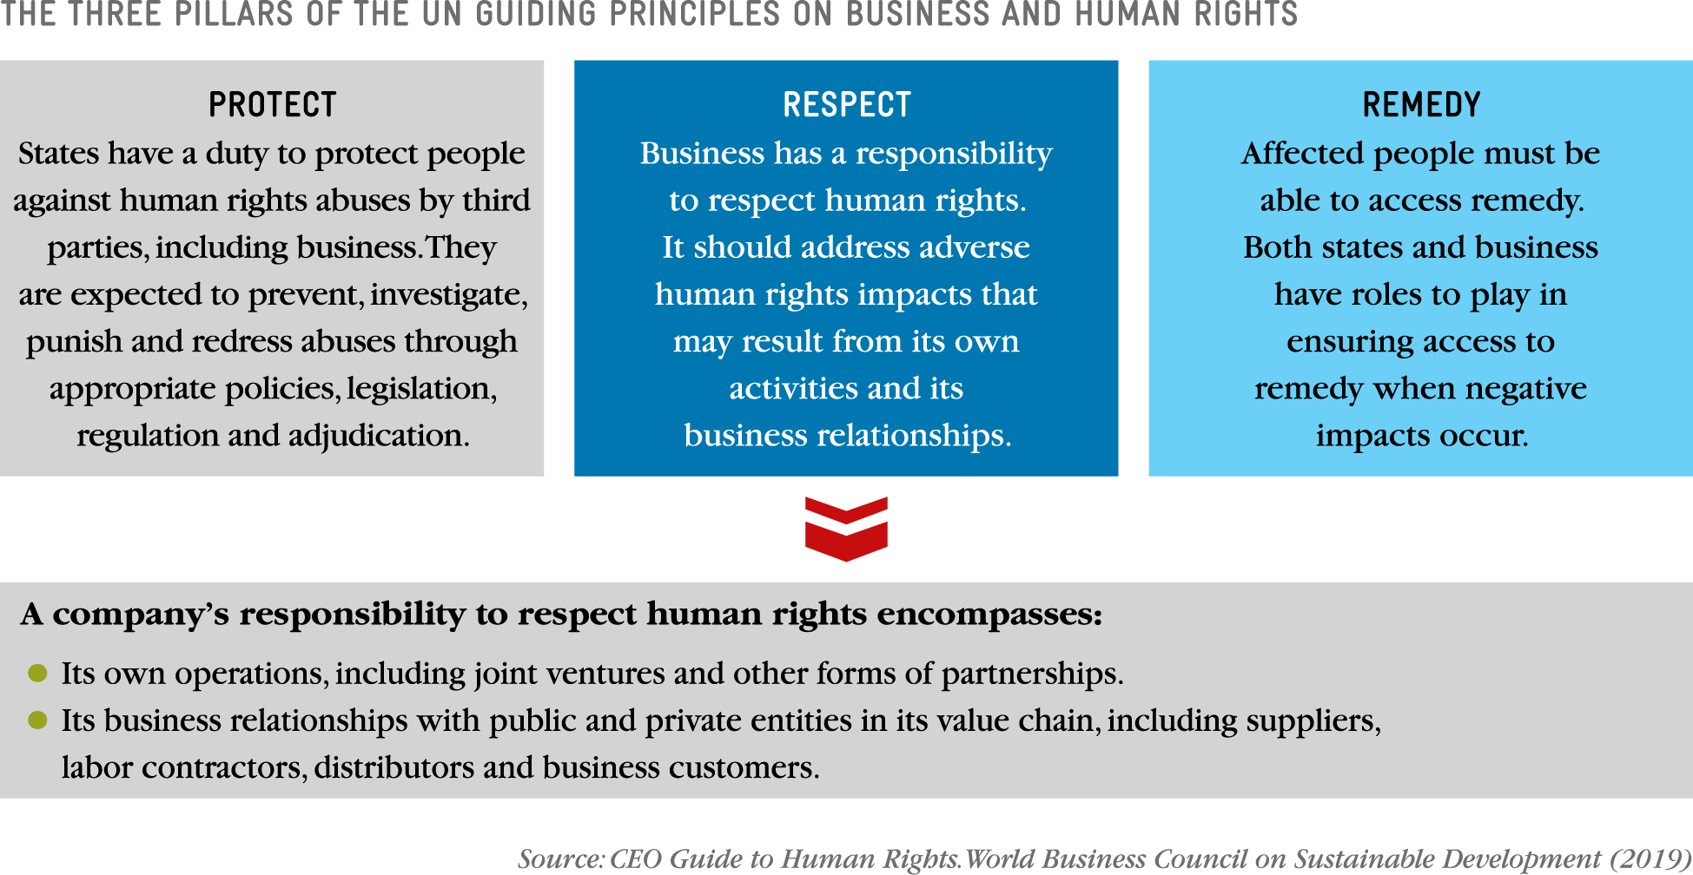
Human Rights
HUMAN RIGHTS
Producers are increasingly included as part of a company’s sphere of responsibility, and therefore they are expected to support a decent standard of living.
Notes:
For some companies, the livelihood of workers and producers is seen as a salient issue within their operations– for example, in cases where forced labour occurs within a large sourcing area or where extreme poverty is prevalent. Producers are increasingly included as part of a company’s sphere of responsibility, and therefore they are expected to support a decent standard of living.
This framing focuses on a risk to people (producers) rather than a risk to the business. It can be framed in the context of a company’s commitment to human rights in its supply chain, its compliance with national human rights legislation or its contribution to international goals such as the UN Guiding Principles or the Sustainable Development Goals. When deciding where and how to take action, a company can take into account the gravity of the problem, the number of producers affected and the remendability or ability of the company to fix the problem. Many companies, such as Mars, Nestlé and Unilever, cite human rights in their company’s livelihood goals.

Slide 20
Human Rights
HUMAN RIGHTS
Examples of National and EU mandatory schemes on business & human rights.
Dutch Child Labor Due Diligence Law (2019)
Australian Modern Slavery Act (MSA) (2018)
New South Wales MSA (2018)
French Duty of Vigilance law (2017)
EU Regulation 2017 / 821 on conflict minerals
UK Modern Slavery Act (2015)
EU Directive 2014 / 95 on non-financial reporting (2014)
US California Transparency in Supply Chains Act (2010)
US Dodd Frank Act (2010)

Slide 21
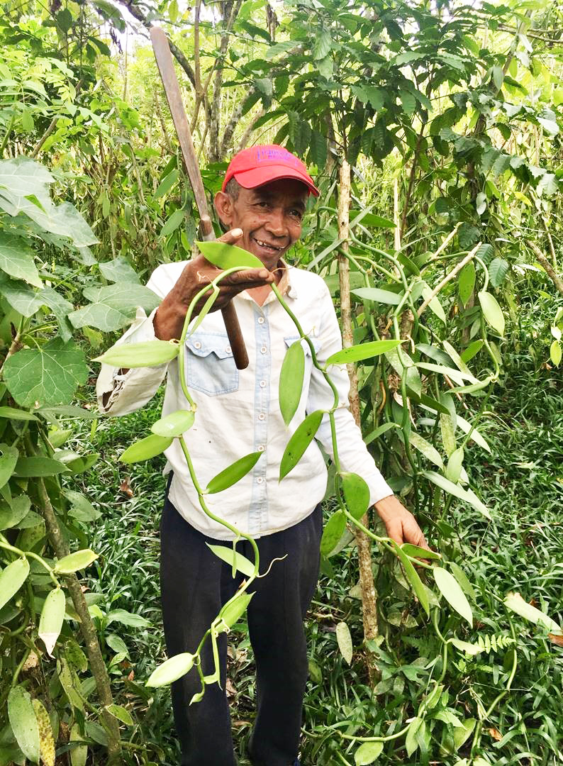
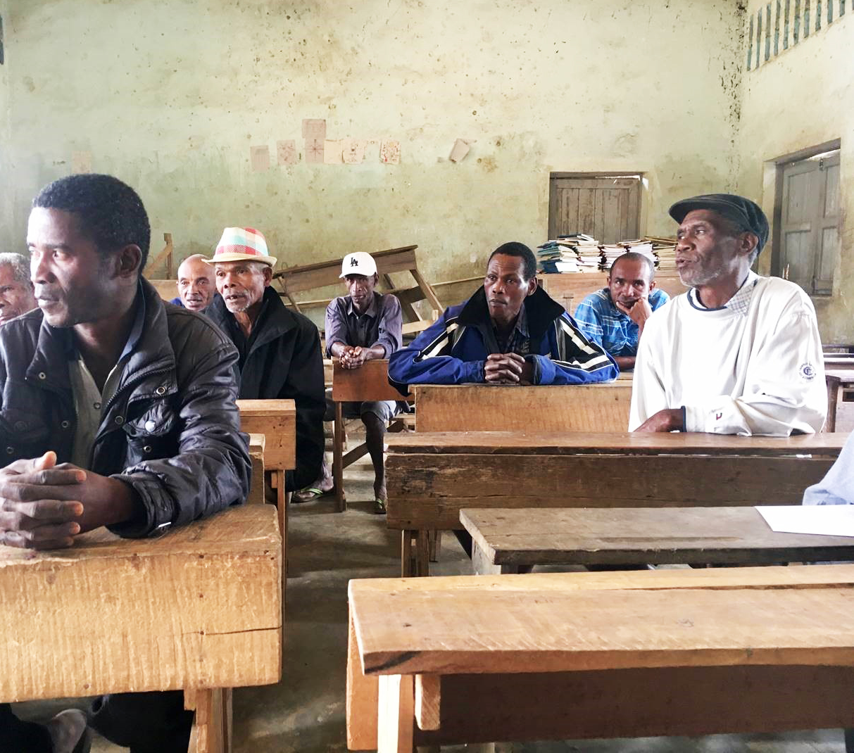
With Increased visibility comes great responsibility
Reputation
Reputation
An Example from the Vanilla Sector
Companies can gain loyalty and respect by showcasing powerful farm stories of happy farmers growing great quality product
Companies can experience negative backlash when allegations of farmer exploitation at the hands of wealthy companies comes to light
In spite of Madagascar’s lushness, hunger is never far away for many of the island’s 25m people. Nearly one in two children are stunted, meaning they are likely to grow up either physically or mentally disadvantaged.
The Livelihoods Fund for Family Farming (L3F) “We focus on agriculture and smallholder farmers who represent a major part of the companies’ supply,”
Medium, 2017
Financial Times, 2018
Notes:
Companies have moved beyond a triple bottom line and are now reporting on all business activities. Honest communication of a company’s actions affects its ability to operate and thrive in an ever-competitive atmosphere, where news reports cover the perceived exploitation of farmers and consumers vote with their wallets. Poverty of smallholder producers and its effects (malnutrition, child labour, migration, etc.) are increasingly showing up in global news, raising awareness among consumers who want to feel good about the choices they make. This type of pressure can be aimed at whole sectors (such as the current “price crisis” in the coffee sector or child labour in the cocoa sector), which can require singular action coupled with sector level multi-stakeholder working groups. Advocates may single out particular companies, such as Mighty Earth’s 2019 campaign against Cargill as “The Worst Company in the World”. In addition, advocacy groups are also making it easier to compare companies so that informed consumer choices can be made.
Left side: https://medium.com/@Danone/transforming-the-vanilla-supply-chain-in-madagascar-99e98dcabe5f
Right side : https://www.ft.com/content/02042190-65bc-11e8-90c2-9563a0613e56

Slide 22
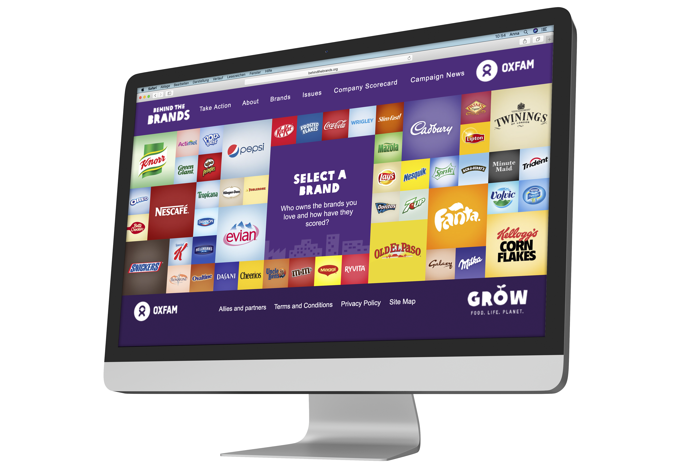
Reputation
Reputation
The website Behind the Brands (shown on the screen to the right) is one of many websites on which civil society organisations monitor company behavior and inform consumers.
Notes:
Additional websites such as Might Earthy exist: https://www.mightyearth.org

Slide 23
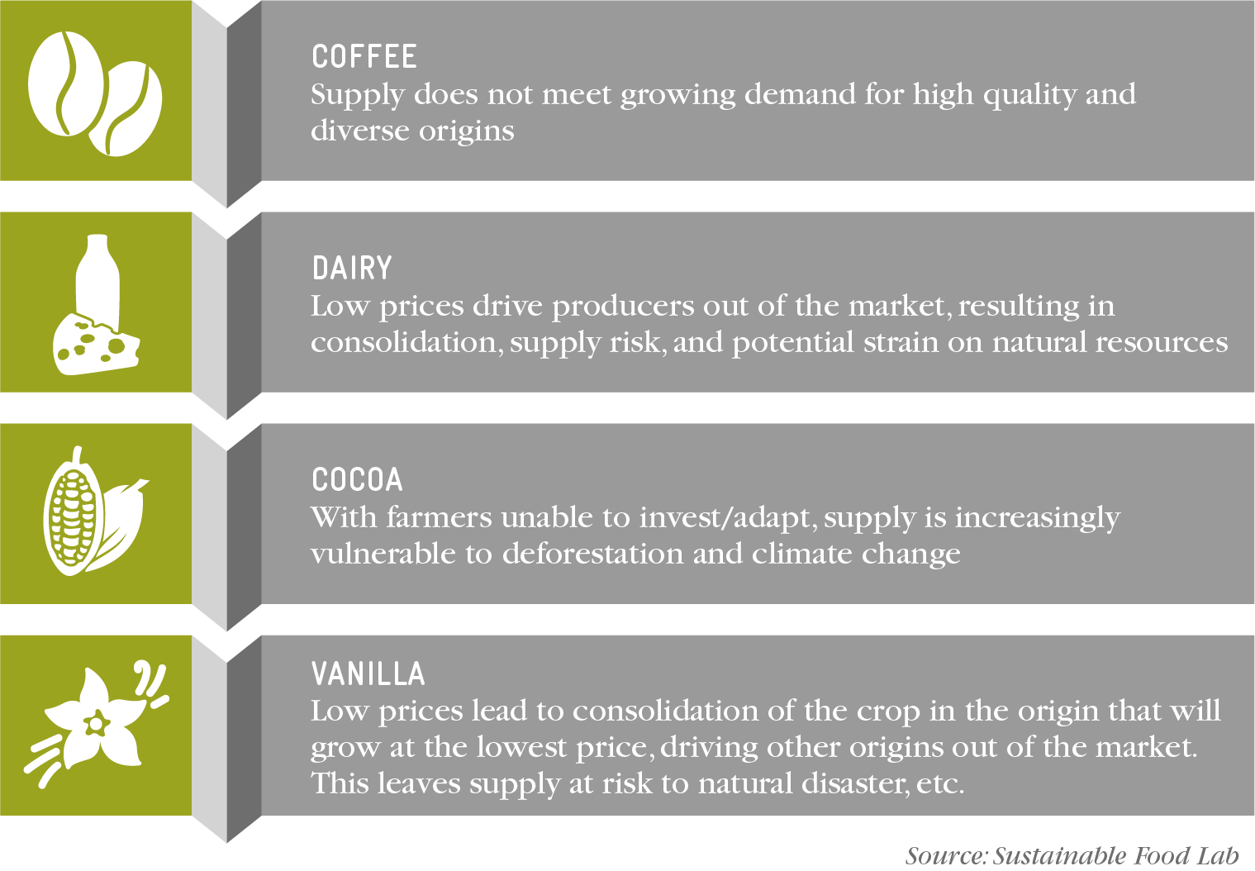
Supply Security
Supply
Security
If farmers cannot invest in their farms, companies may not be able to source the quality ingredients their customers expect in the future.
Notes:
For companies that count on farmers to continue producing quality crops, especially from diverse origins, lack of farm-level investment is a threat to both quantity and quality of supply. Supply security risks present themselves differently across sectors. As farmers realise that their crop of choice is not providing for their families, they (and their children) may choose other ways of making a living, either leaving the company’s priority crop production, growing less of it or with poorer quality, or leaving agriculture altogether. In other instances, low prices and lack of farmer investment leave supply increasingly vulnerable to climate change, deforestation or natural disaster.

Slide 24
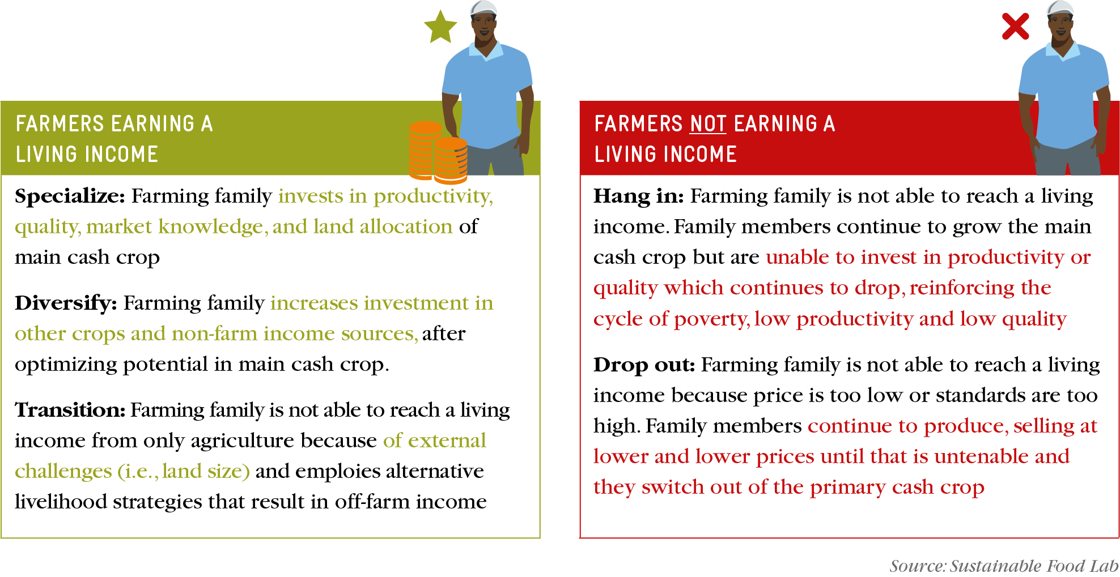
Supply Security
Supply
Security
Notes:
Supply chains are made up of a diverse set of smallholder farmers. Farmers can be focused on one crop or can be diversified and earning money from several cash crops, and may differ in their family make-up, farm size and professionalisation. In order to earn a living income, farmers must generally reach a good productivity level, produce on land that is viable in size and receive a price that at a minimum covers the cost of production with a return for family labour. These farmers have the elements in place to invest in their farms and continue to thrive. Those that do not meet these criteria and do not earn a living income will either hang in – with low productivity and quality reinforcing the cycle of poverty and susceptibility to shock – or drop out when prices are too low and standards too high to make agriculture a viable livelihood strategy.

Slide 25
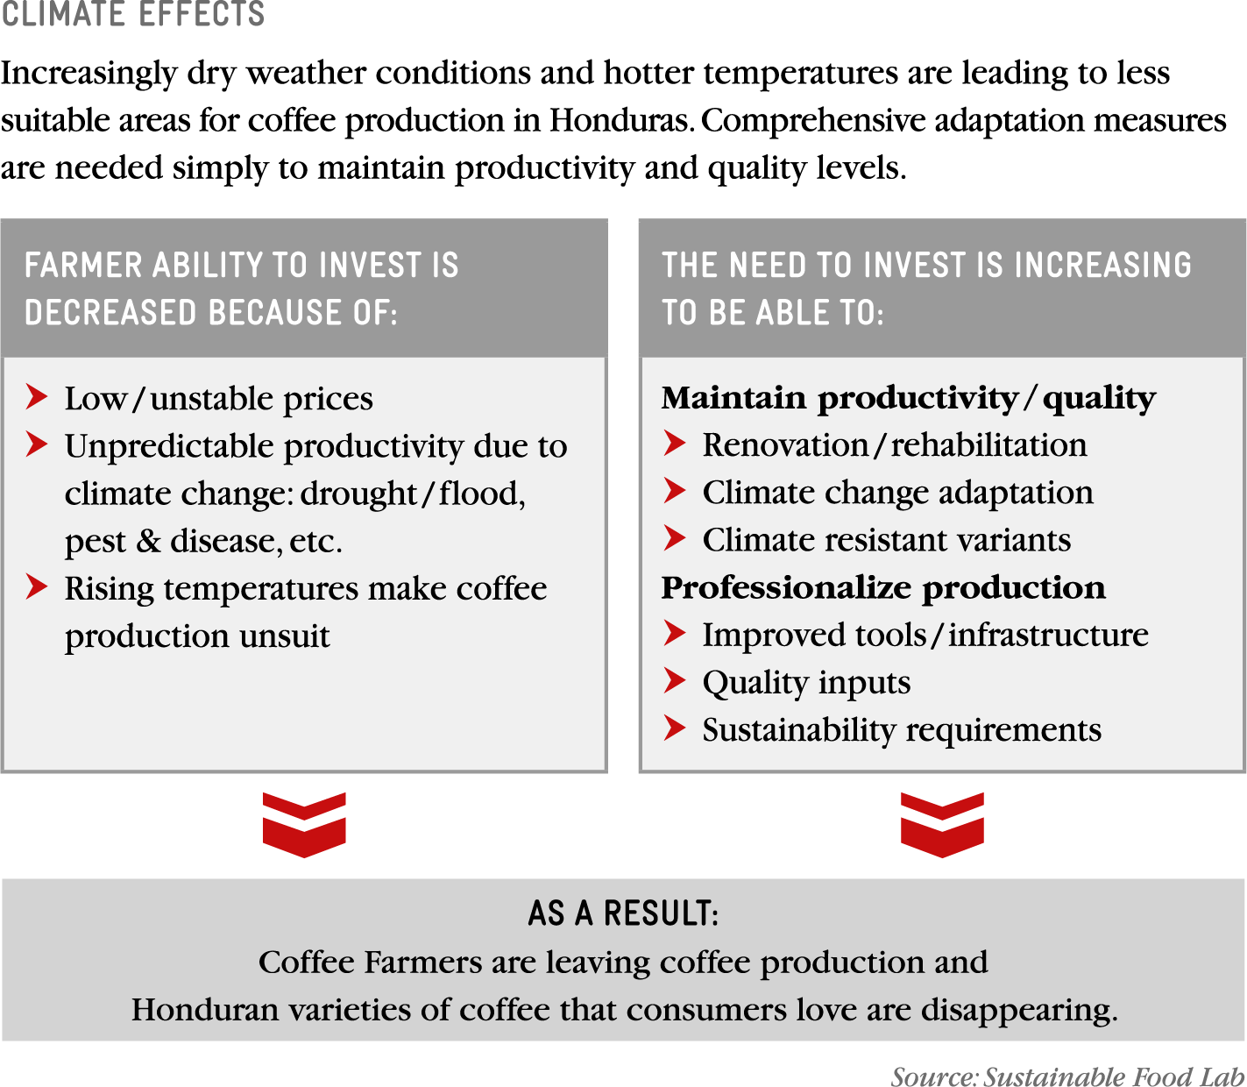
Supply Security
Supply
Security
Farmers who are unable to reach a living income and therefore unable to invest in farms are even more susceptible to the effects of climate change which further threatens security of supply.
Notes:
Honduras is the largest producer of coffee in Central America and, like many other countries in the region, it is unmistakably feeling the effects of climate change. In practice, this means that comprehensive adaptation measures are needed simply to maintain productivity and quality levels. At a time when more investment is needed, coffee prices are at a historic low. Farmers struggling to cover the costs of production drop out of coffee, and some of the coffee varieties consumers love are disappearing.

Slide 26
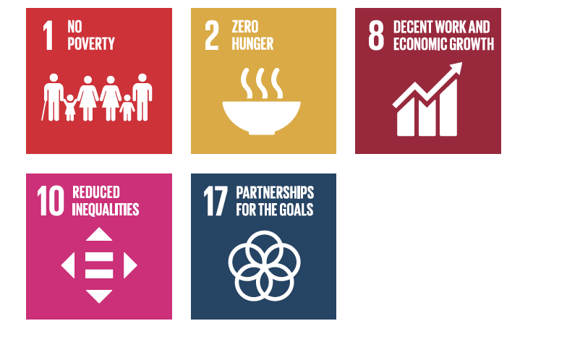
Living Income and the SDGs
Connecting to SDGs
The business strategy on living incomes should be formulated in line with inclusive business principles. It should state that the company prioritises the inclusion of smallholder farmers in its supply chain and is committed to a pathway towards a living income for those farmers. Commitments to the following SDGs can support the principle of inclusion:

Slide 27



Living Income in Your Industry
Cocoa
World Cocoa Foundation
International Cocoa Initiative
Swiss Platform for Sustainable Cocoa
Beyond Chocolate (Belgium)
German Initiative on Sustainable Cocoa
Dutch Initiative on Sustainable Cocoa
Coffee
Task Force for Coffee Living Income
ICO Public Private Task Force
Vanilla
Sustainable Vanilla Initiative
Tea
Ethical Tea Partnership
Malawi 2020
Tobacco
Sustainable Tobacco Partnership
Cross Sector Initiatives
INA (Initiative for Sustainable Agricultural Supply Chains)

Slide 28
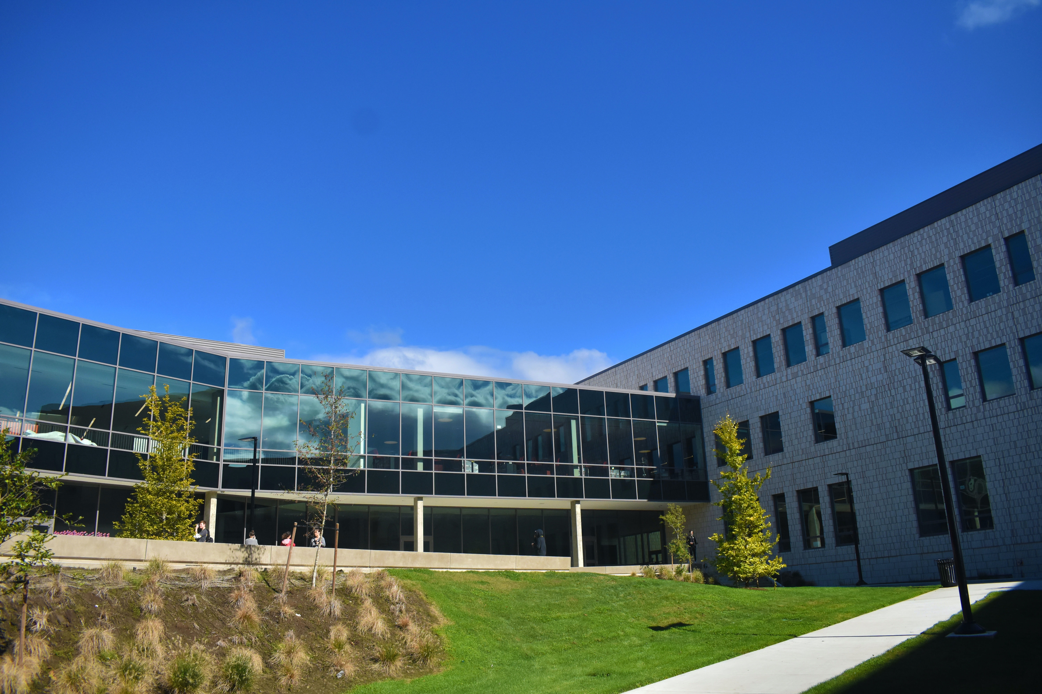
Company Examples

Slide 29


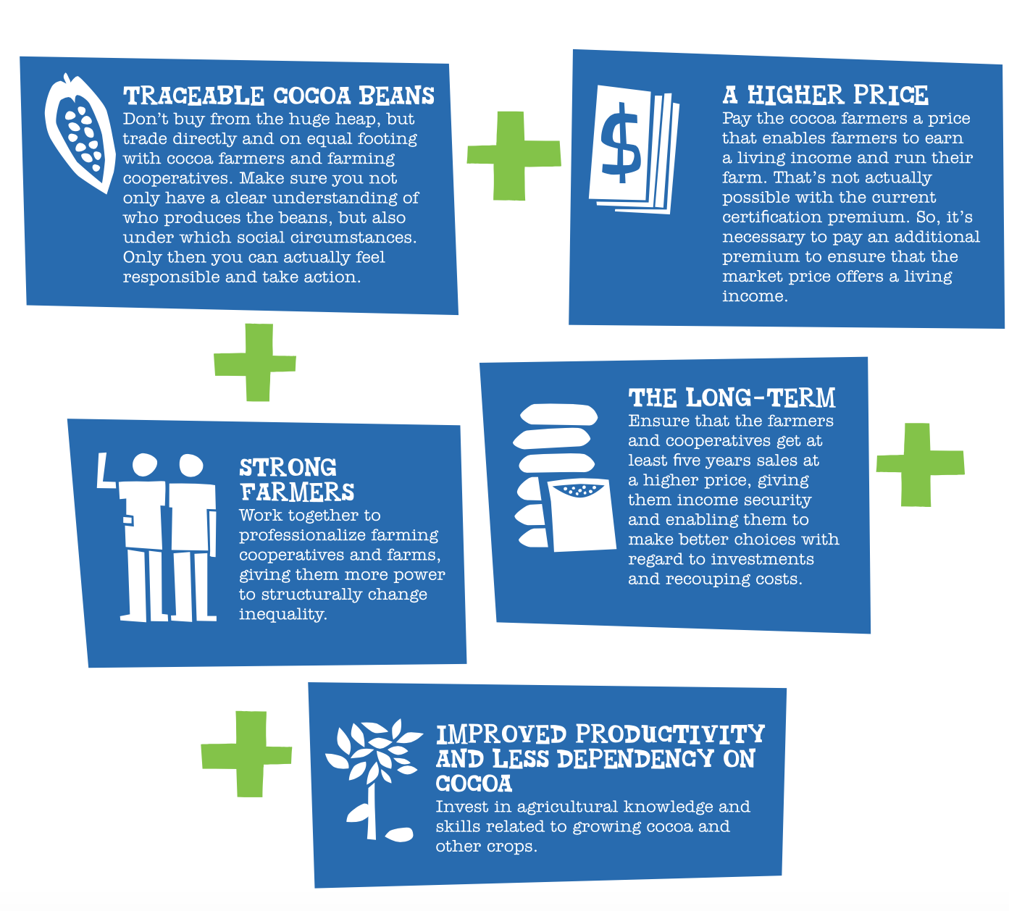
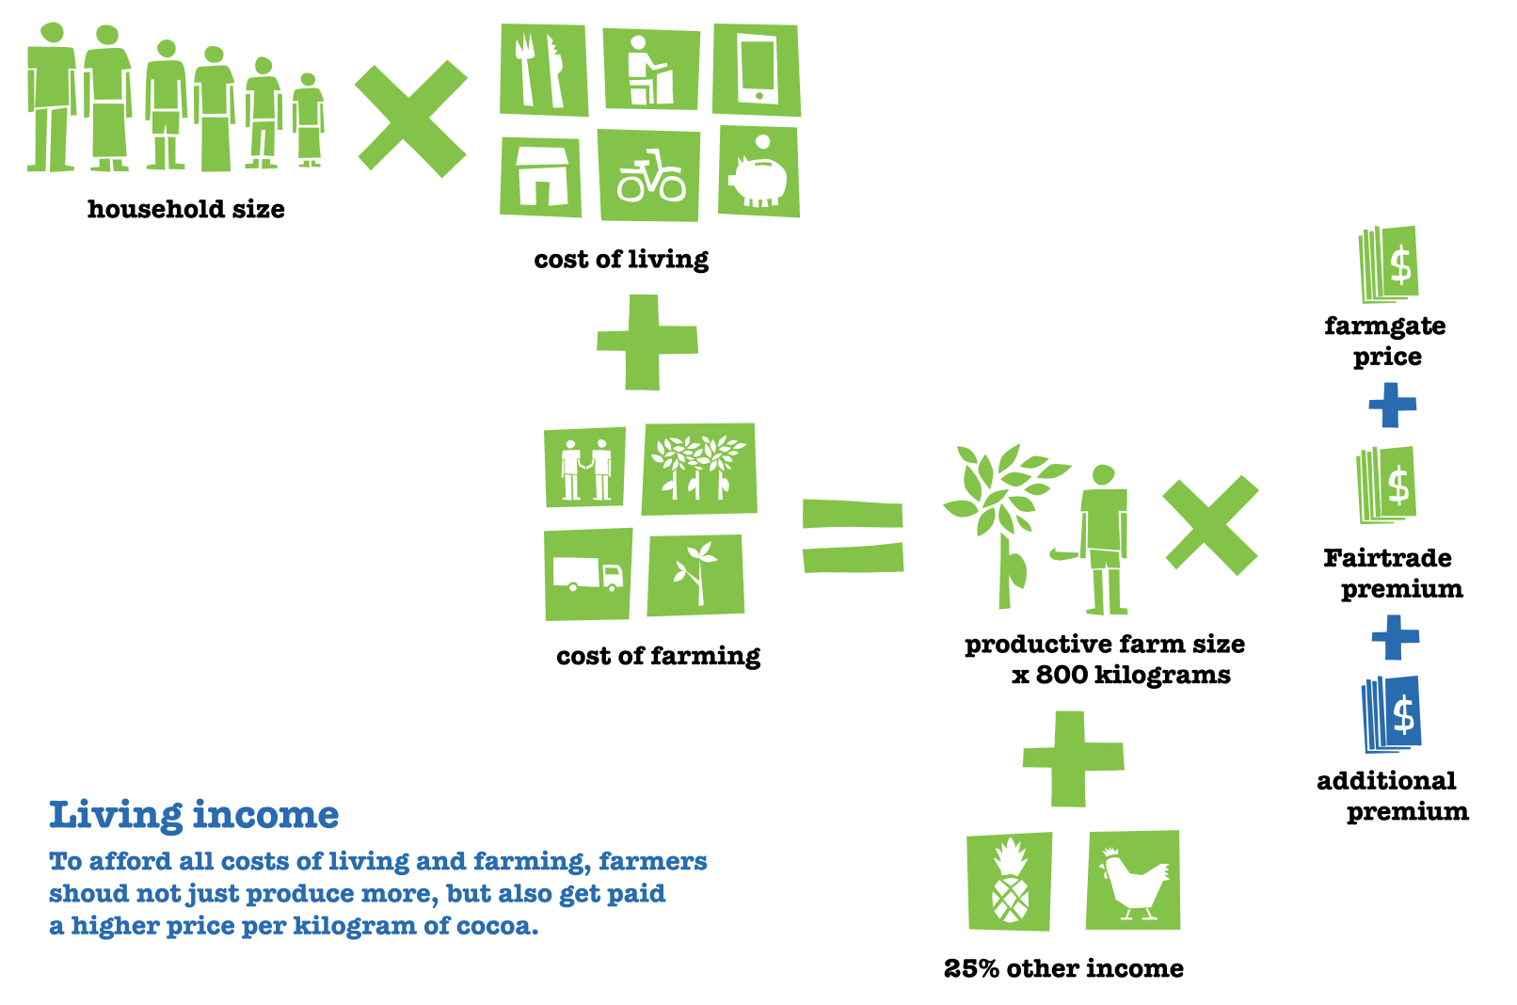
Living Income Company Spotlight
Notes:
https://tonyschocolonely.com/us/en/annual-fair-reports/annual-fair-report-18-19
“To ensure that other players in the supply chain (such as local and international traders, cocoa processors and chocolate bar manufacturers) do not all receive a percentage of this higher price, we pay the additional premium directly to the cooperatives we work with. The members of the cooperative decide among themselves how the premium is spent. Each year, the cooperatives hold an annual meeting during which finances are openly discussed and the members approve the way the premium is spent. We aim to ensure that at least 50% of the premium is paid to the farmers in cash. Part of the premium needs to be spent on training and managing the cooperatives. It is also used to pay for equipment, such as a vehicle to collect the bags of cocoa from the farmers.”

Slide 30

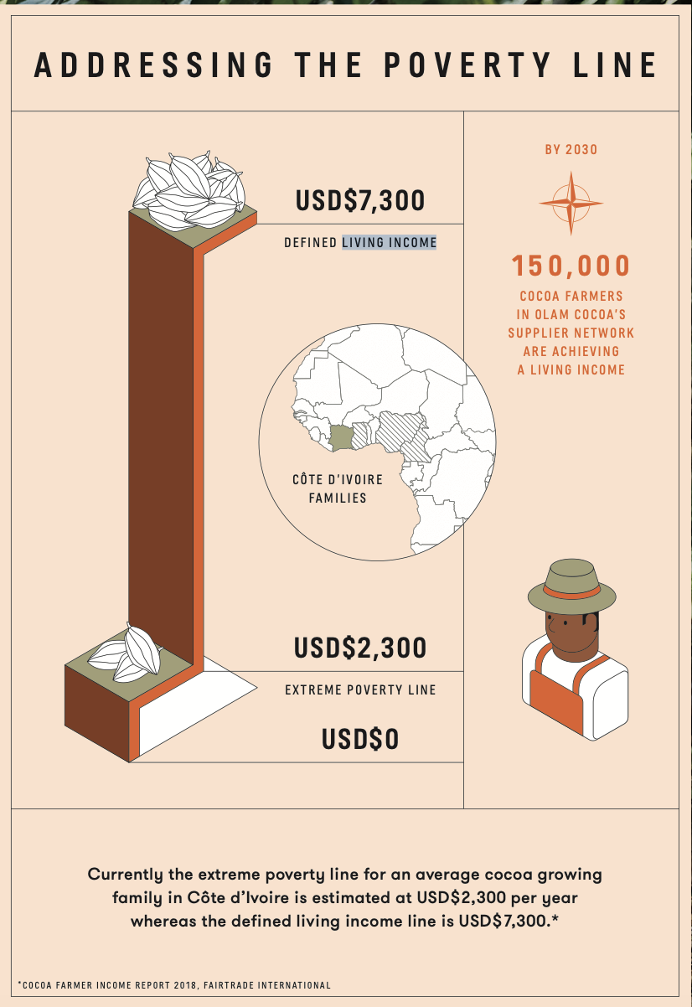
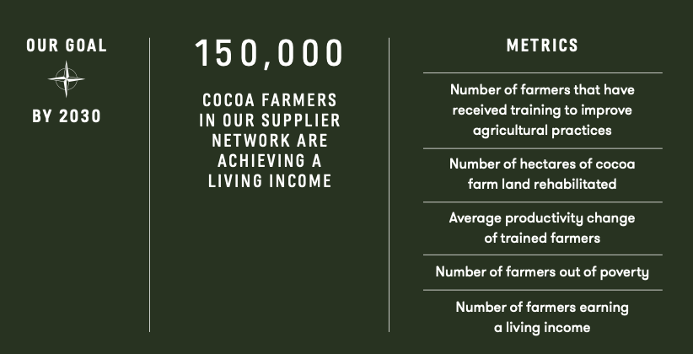
Living Income Spotlight
Notes:
https://www.olamgroup.com/news/all-news/press-release/cocoa-compass-olam-cocoa-commits-to-living-incomes-for-farmers.html
https://www.olamgroup.com/olam-cocoa-compass.pdf

Slide 31

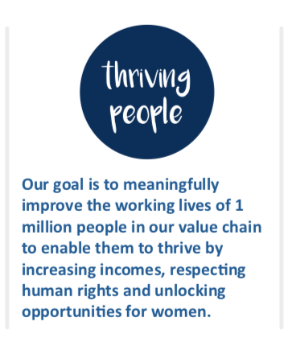
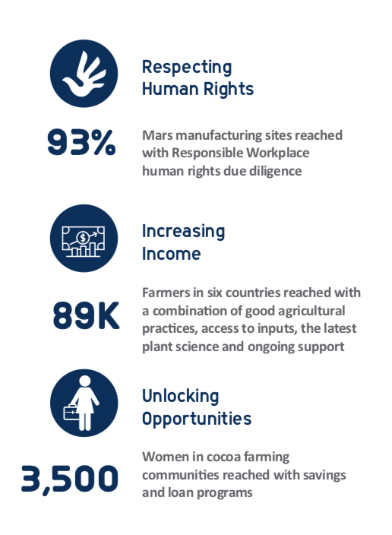
Human Rights Spotlight
Notes:
https://gateway.mars.com/m/45f64dd4411a8c82/original/Mars-Sustainability-Report-English.pdf

Slide 32

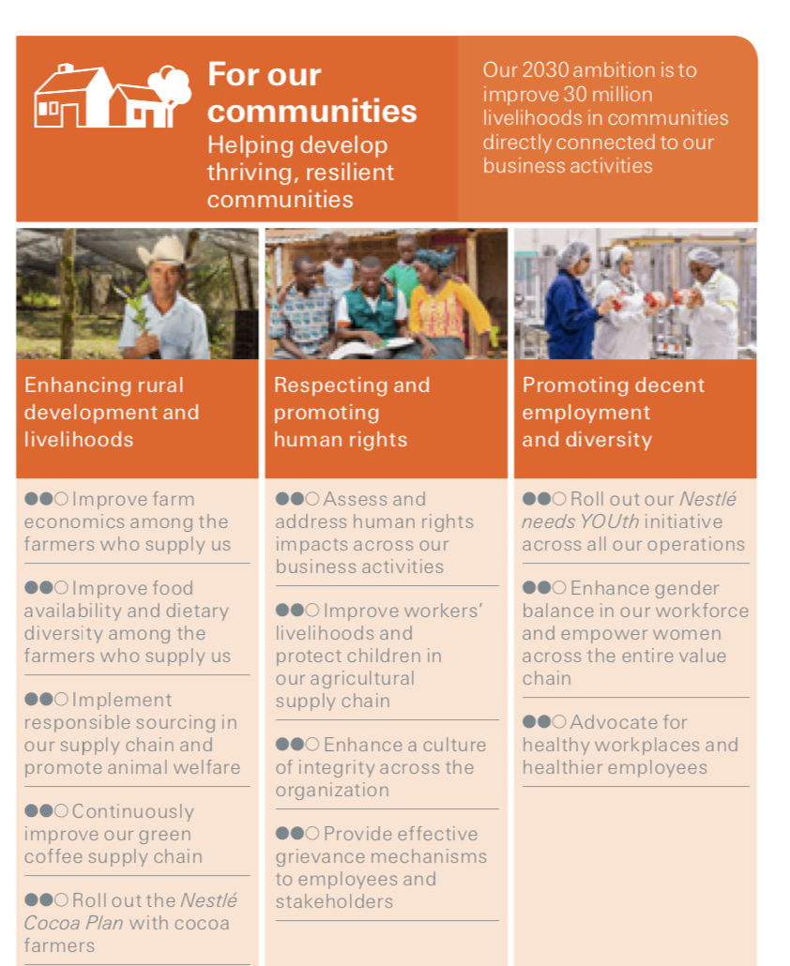
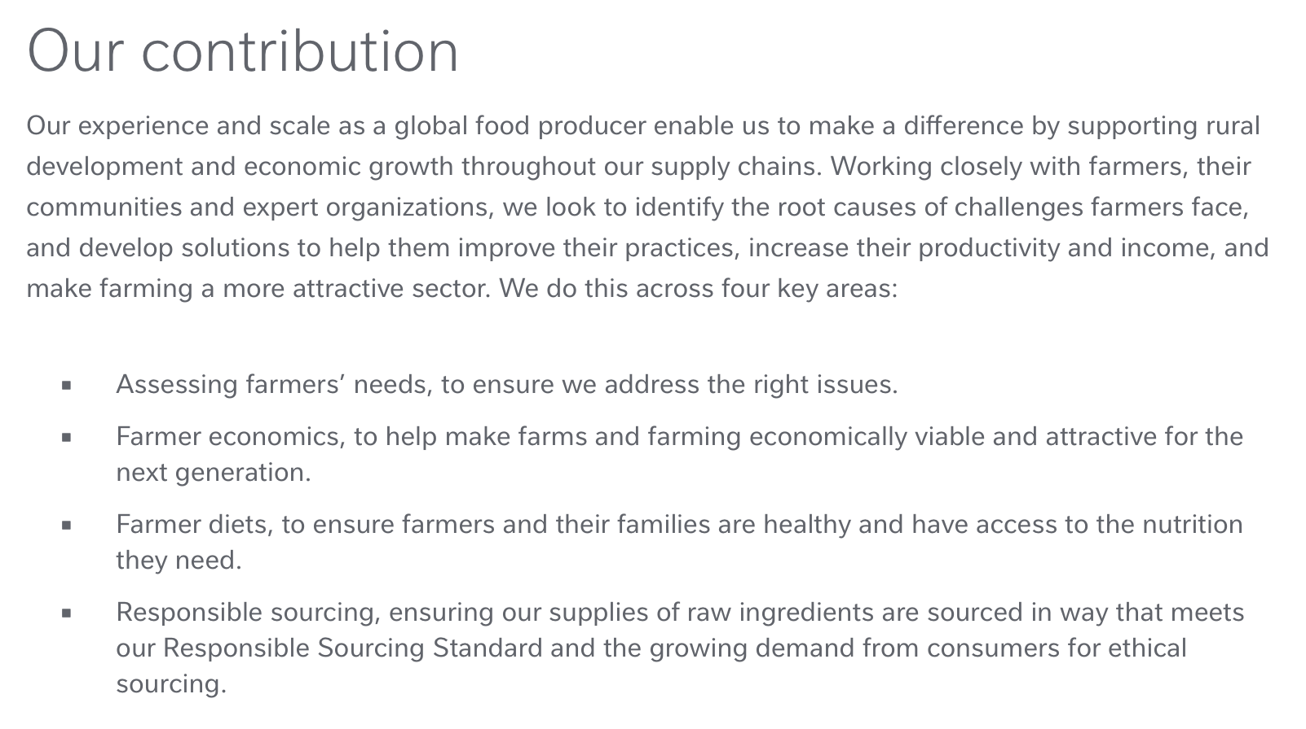

Human Rights Spotlight
2030 Ambition To improve 30 million livelihoods in communities directly connected to our business activities.
Notes:
https://www.nestle.com/sites/default/files/asset-library/documents/library/documents/corporate_social_responsibility/creating-shared-value-report-2018-en.pdf

Slide 33

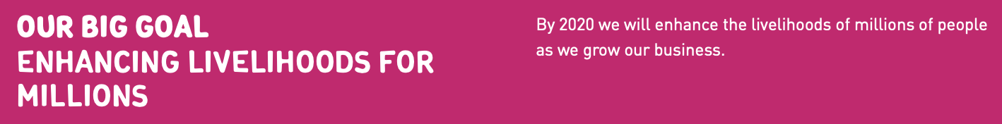
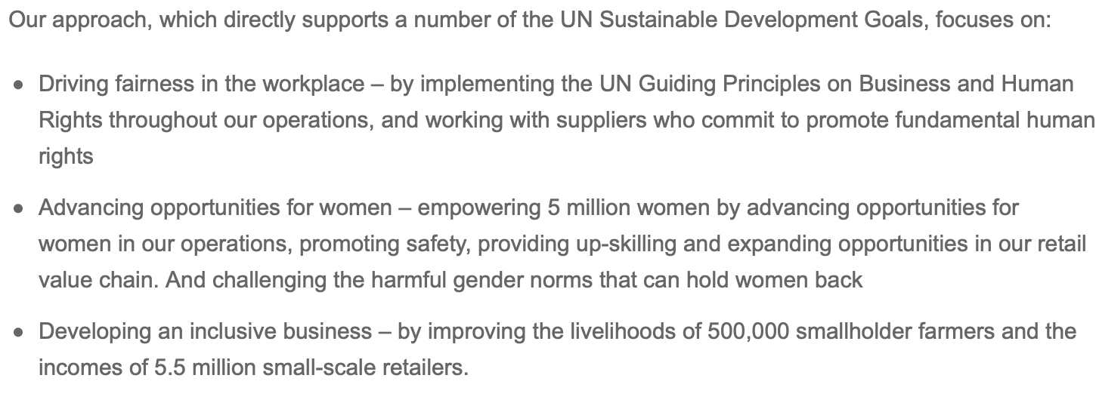
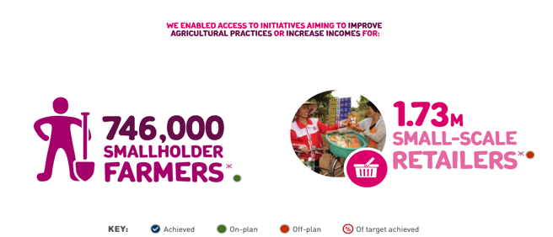


Human Rights Spotlight
Unilever’s ‘Enhancing Livelihoods’ goal is made up of 3 pillars:
Fairness in the Workplace, Opportunities for Women and Inclusive Business
Notes:
https://www.unilever.com/sustainable-living/enhancing-livelihoods/fairness-in-the-workplace/advancing-human-rights-in-our-own-operations/

Slide 34
Learn How to Prepare for Action
Slides will be available shortly.

