Slide 1


Living Income Toolkit
Prepare for Action

Slide 2
How to Use
This Living Income Toolkit Slide Deck was designed as a support resource for companies and is a supplement to the Toolkit “Guiding steps towards living income in the supply chain: How to mainstream living income in your company’s activities”. Please feel free to use this slide deck ppt for your own purposes, while maintaining the crediting included (all sources can be found in the notes section).
The complete Living Income Toolkit (pdf) is available online here:
Living Income Toolkit
Other resources are available, including:
Make the Case
Take Action

Slide 3
Table of Contents
Step 1: Build Understanding
Step 2: Materiality
Step 3: Traceability and Hotspot Analysis
Step 4: Communicate Expectations on Living Income and Engage Suppliers
Step 5.1: Define Living Income Benchmarks
Step 5.2: Determine Actual Incomes and Measure Gaps

Slide 4

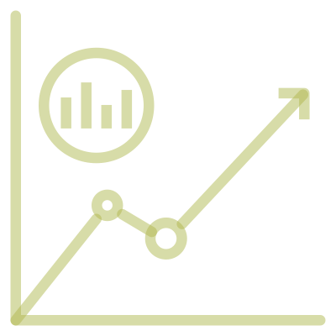


Materiality
What raw materials will you focus on and in what location(s)?
Measurement & Evaluation
Are strategies working?
Benchmarking
Is there a benchmark for the location(s)?
Measurement & Evaluation informs strategy re-design
Strategy Development & Implementation
What strategies will you use to ”close the gap”?
Actual Incomes
Do you know farmers’ actual incomes?

Slide 5

Step 1:
Building Understanding

Slide 6
The Living Income Concept
What is the Living Income Concept?
What does it mean to be able to afford a decent standard of living?
What does decency mean in this context?
The concept of a Living Income focuses on the households’ ability to afford a decent standard of living.
The net annual income of a household, which comes from a variety of sources, is sufficient to cover the cost of a decent standard of living for a typical household in a particular place.
Elements of a decent standard of living include access to food, water, housing, education, healthcare, transport, clothing, and other essential needs including provision for unexpected events.
Notes:
The concept of “living income” applies the concept of a living wage to a farming household and is defined as the net household income needed for a farming household to afford a minimum decent standard of living. Living income is not about meeting minimum or baseline levels of income. It emphasizes the need to be able to provide for a household to live comfortably.

Slide 7
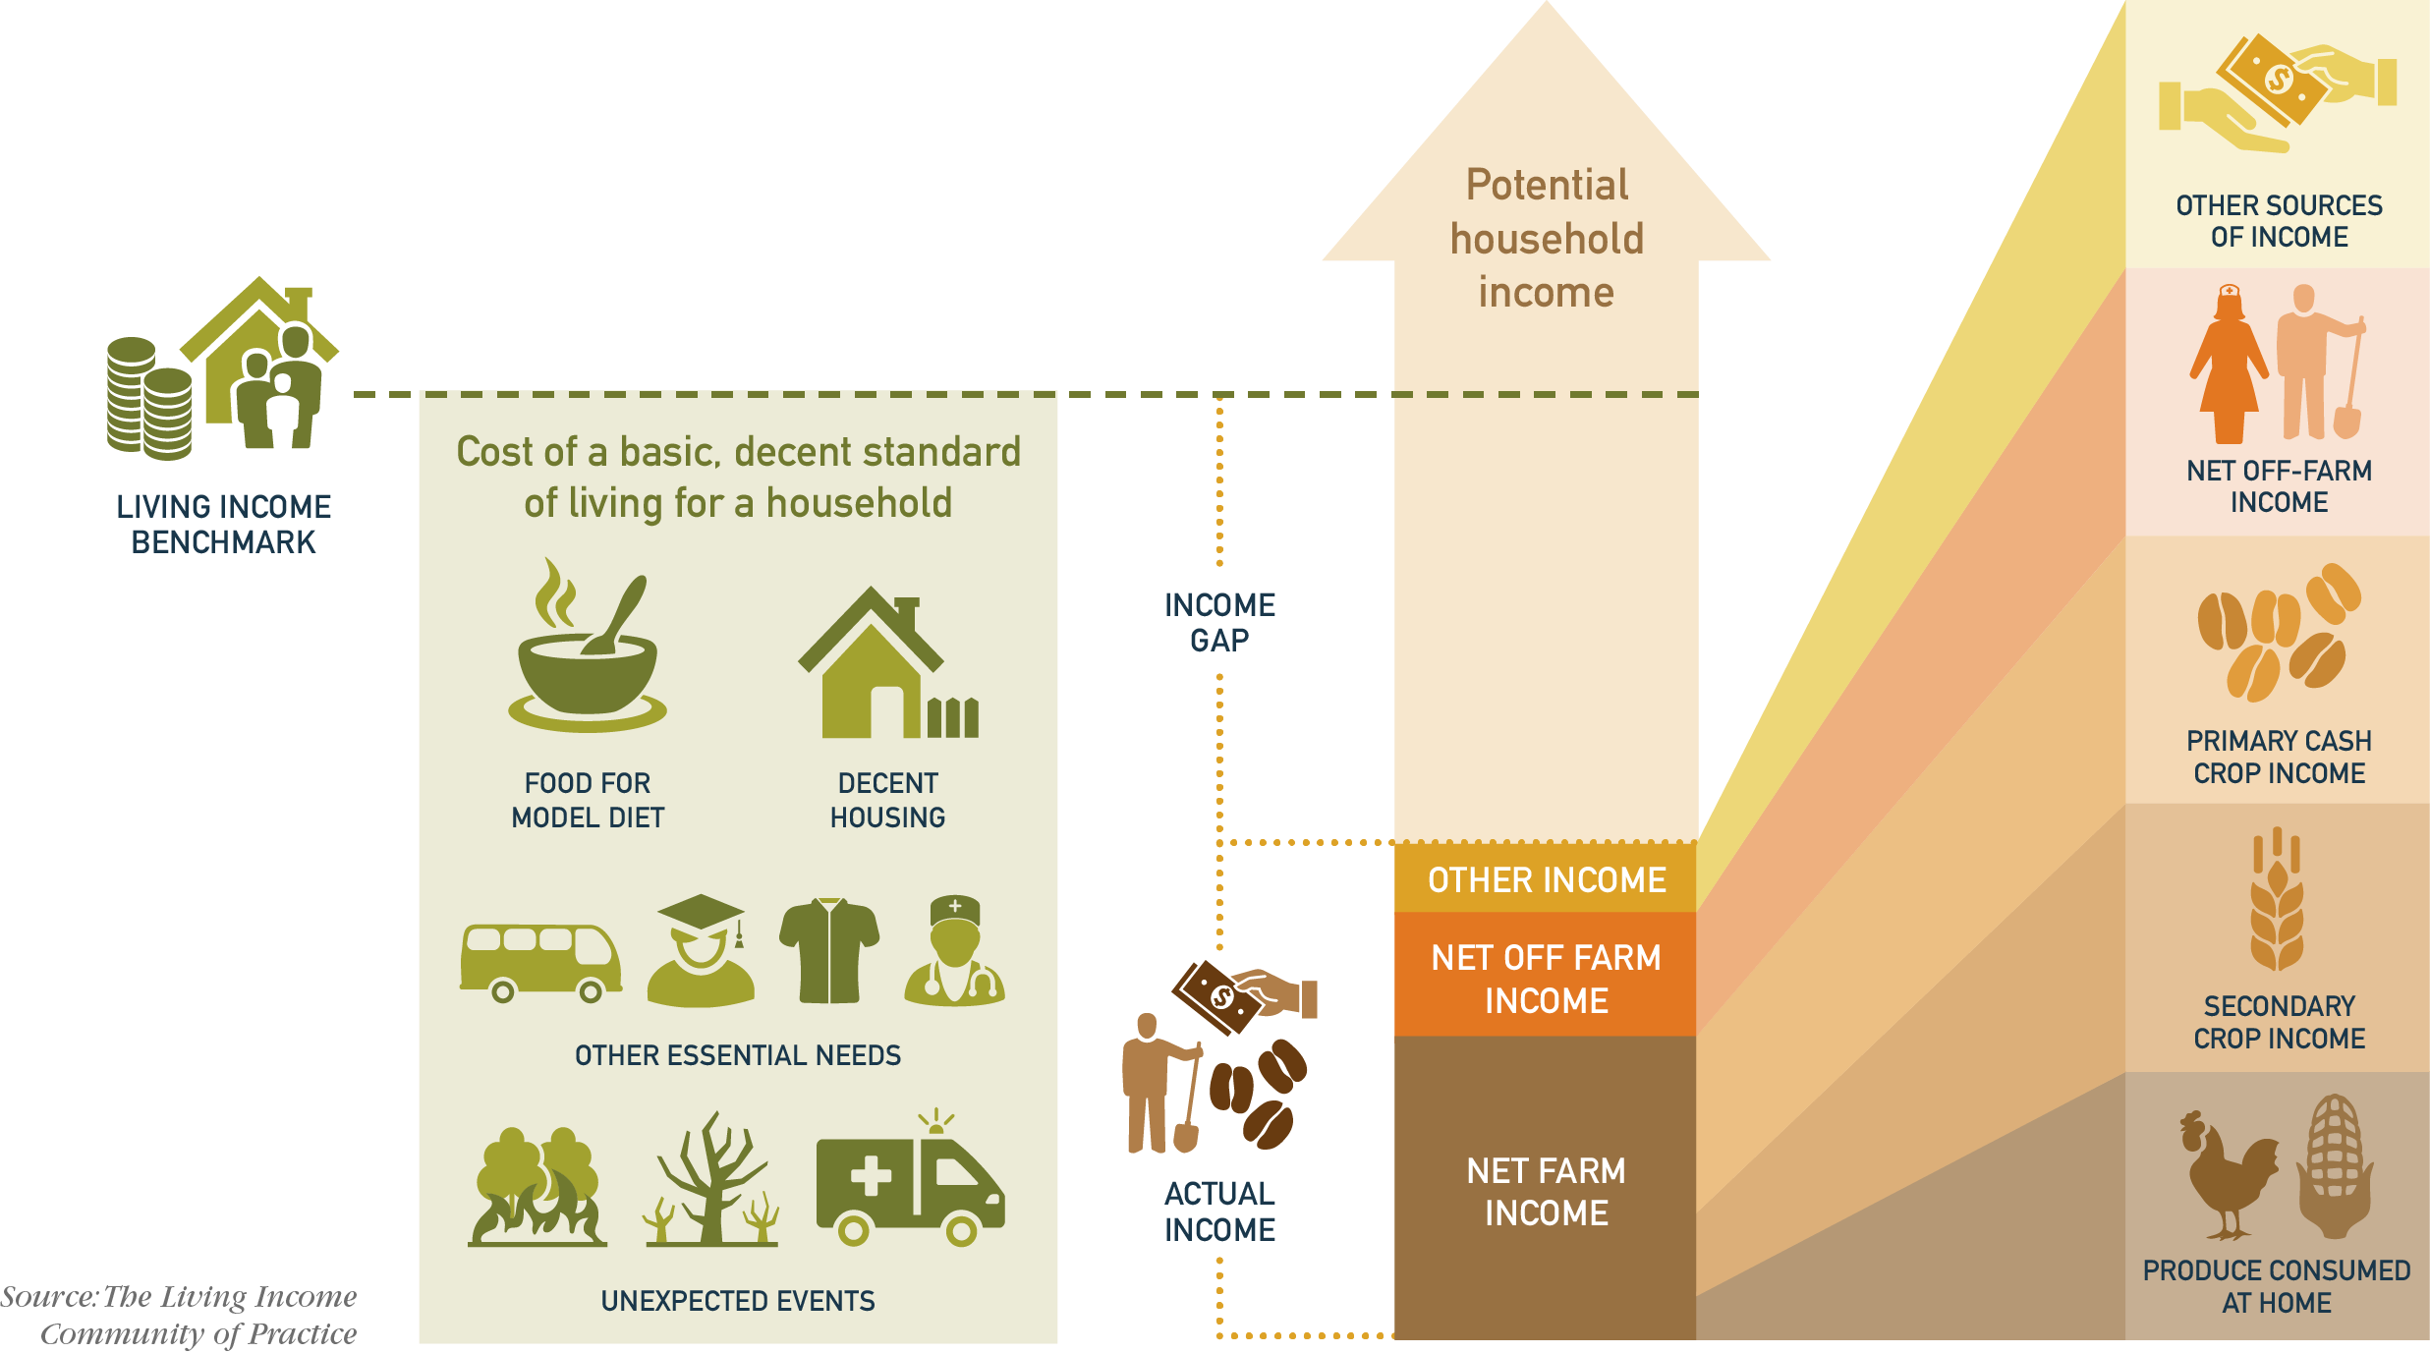
The Living Income Story
Notes:
The Living Income Story, as illustrated above, shows the basic building blocks of a living income.

Slide 8

Notes:
Living Income Video: https://www.youtube.com/watch?v=f3pVHryU8t8&feature=emb_logo

Slide 9
Learn More About Living Income
The Living Income Community of Practice is an alliance of actors from various sectors (private sector, civil sector, academia). Its aim is to improve smallholders’ income by combining the levers of the different actors. Within this collaboration, businesses can learn from the experiences of their alliance partners and make use of the methods and guidance offered by these in order to contribute to closing the income gap.
Join the conversation on www.living-income.com
About
The Concept
Applications
Living Income and the SDG’s
Measurement
Measuring Living Income
Actual Income
Living Income Benchmarks
Living Income Proxy
Closing the Gap
Cases and Collaborations
Roles of Different Actors
Leveraging Improvement
Resources
Graphics
Newsletters
Papers & Reports
Recorded Webinars
Events
Upcoming Events
Previous Events
Notes:
The Living Income Story, as illustrated above, shows the basic building blocks of a living income.

Slide 10
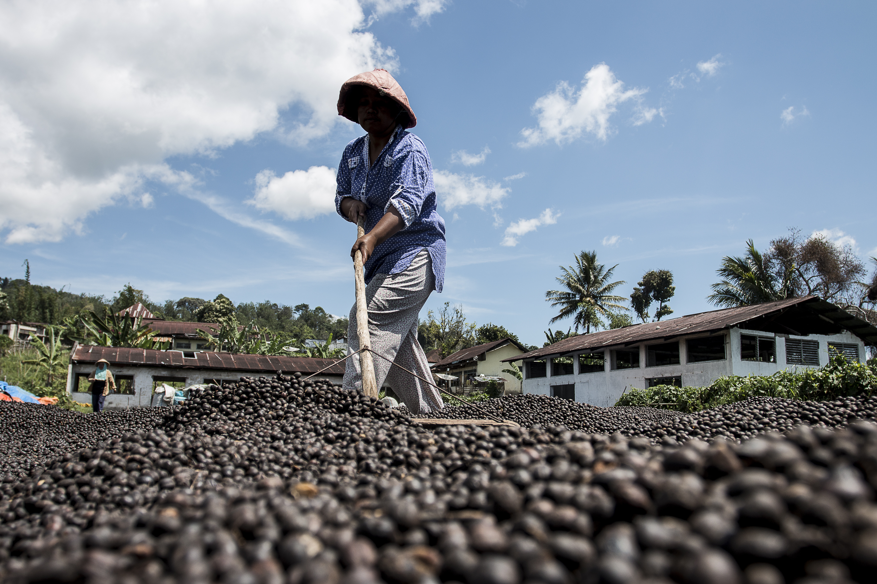
Step 2:
Materiality Identifying
your key raw
materials

Slide 11


About
A sustainability materiality analysis is a structured process to consider the economic, social and environmental impacts of a business’s operations and/or the ‘material issues’ most important to a business.
Action:
Determine raw materials purchased by the company that are critical from a commercial spend and volume perspective.
Map the incidence and severity of poverty in the origins of these raw materials.
Notes:
The Living Income Story, as illustrated above, shows the basic building blocks of a living income.

Slide 12
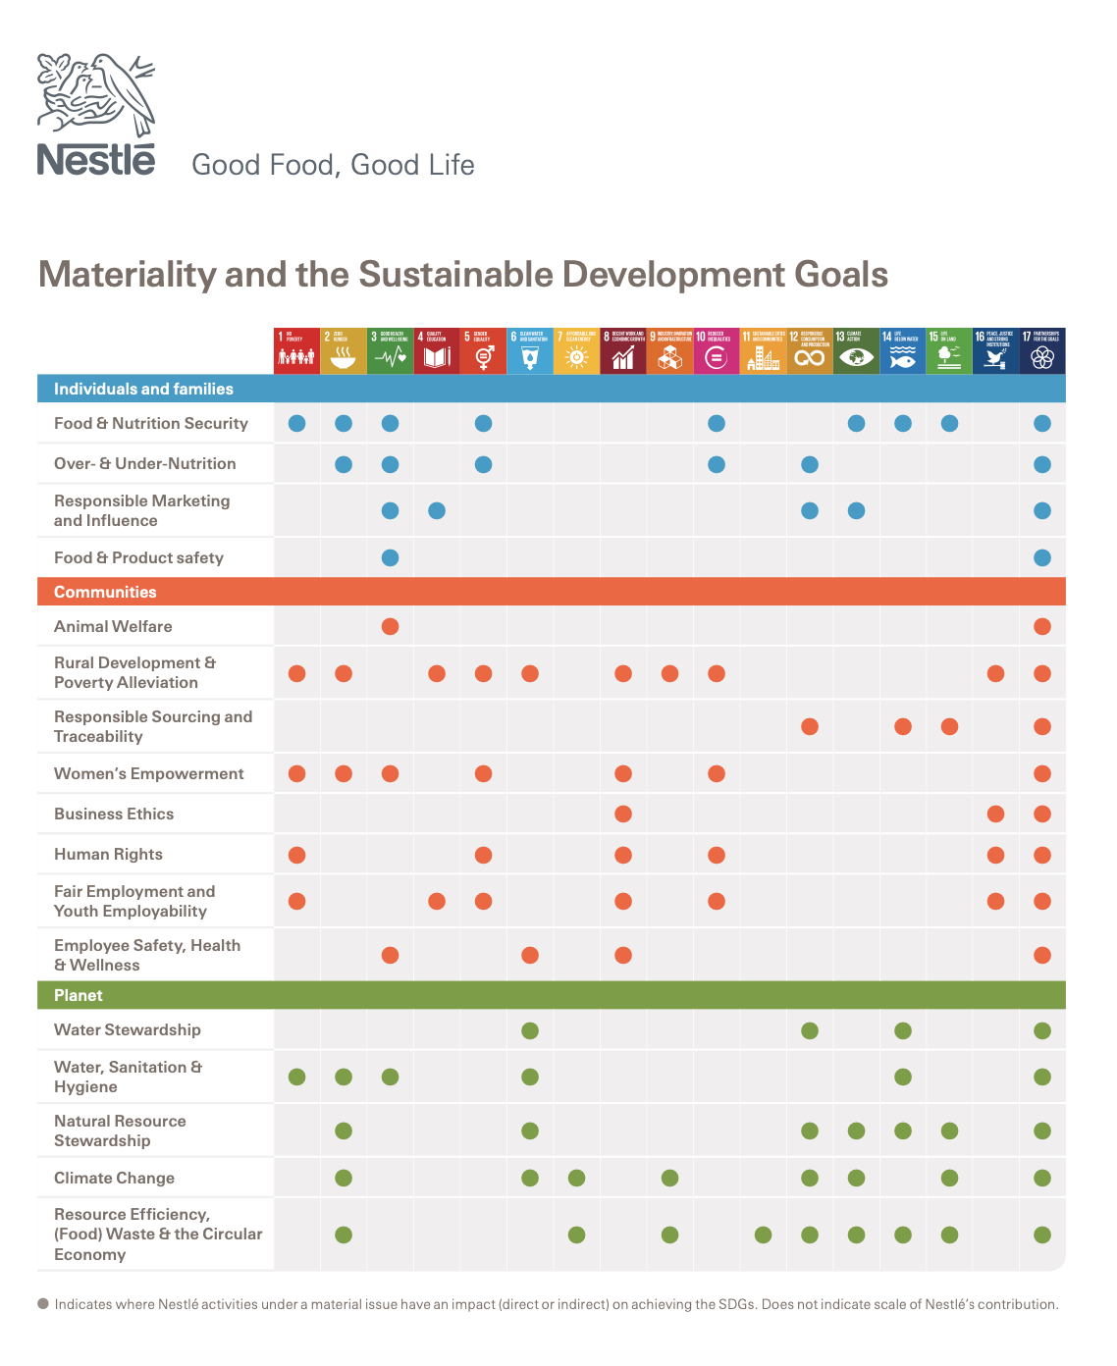
Example Materiality Assessment:
Nestle
Learn more about Nestle’s Materiality here.
Notes:
https://www.nestle.com/sites/default/files/asset-library/documents/creating-shared-value/materiality-and-sdgs.pdf

Slide 13
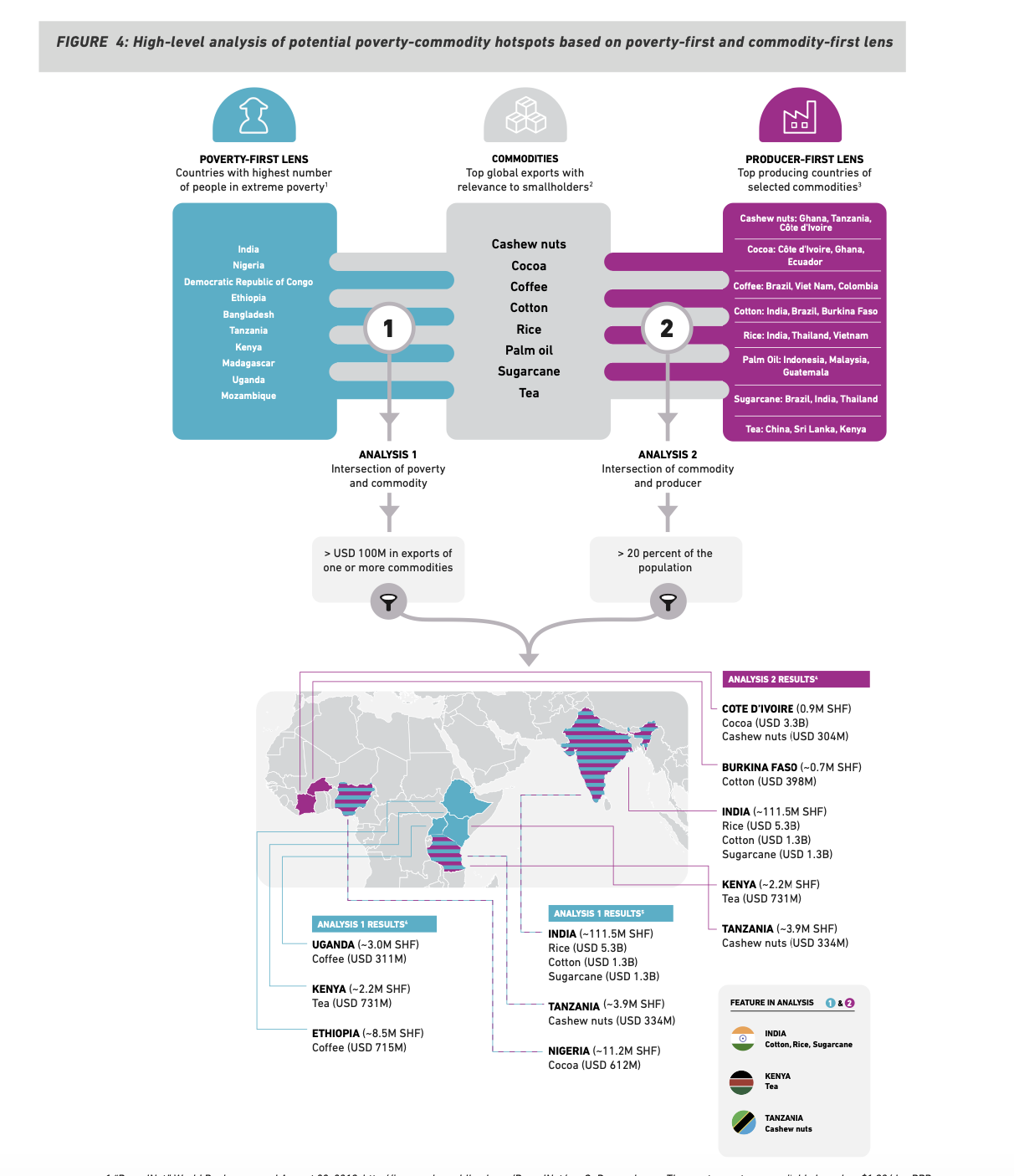
Example Materiality Assessment:
Farmer Income Lab
Learn more about the Farmer Income Lab here.
Notes:
https://www.farmerincomelab.com/sites/g/files/jydpyr621/files/2020-09/FINAL%20FINAL%20Poverty%20Hotspots%20UNGA%202019_2.pdf

Slide 14
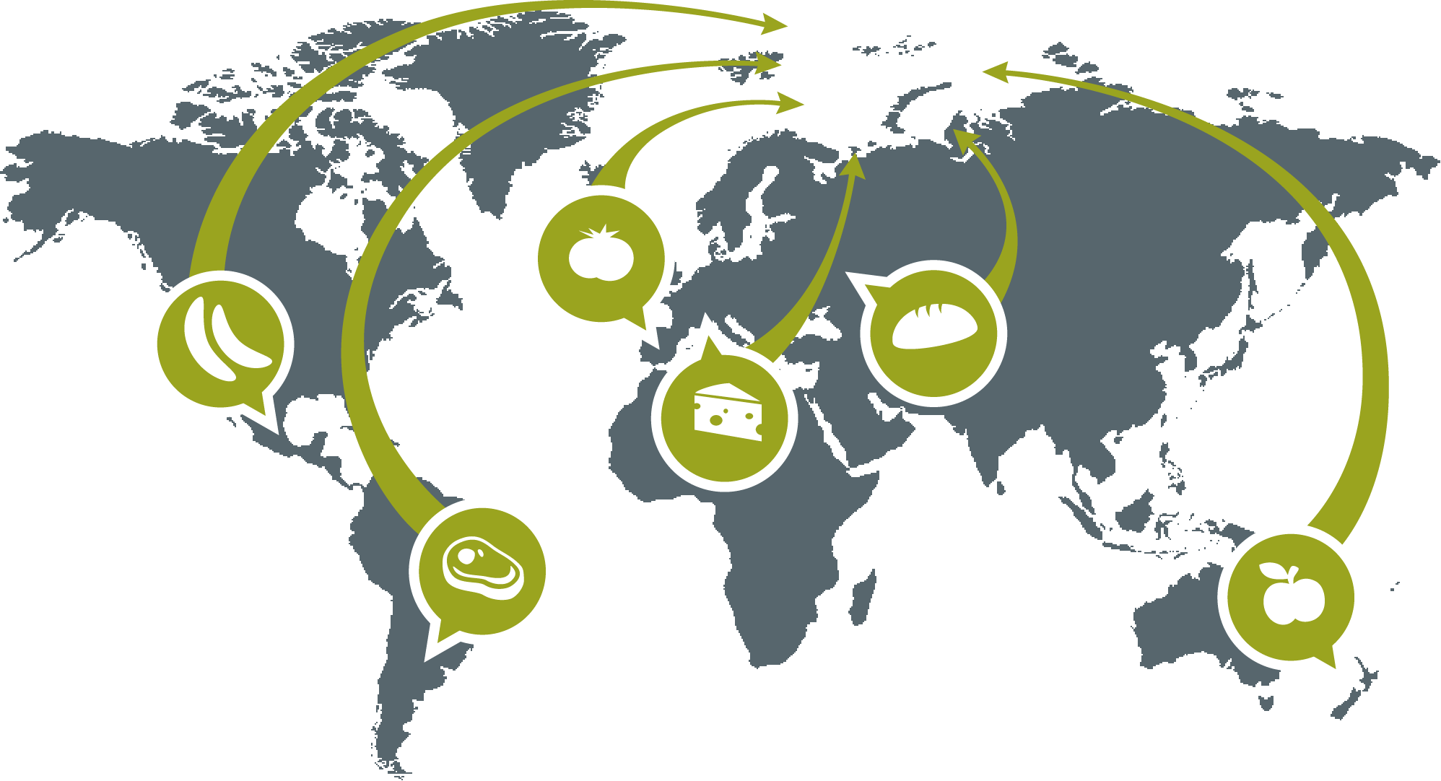
Step 3:
Traceability and Hotspot Analysis
Identifying

Slide 15
Tracing Raw Materials &
Finding Hotspots of Poverty
CONTEXTUAL FACTORS
CHAIN & FARMER ORGANIZATION
FARMER DATA
Completed through a combination of the following:
Supplier engagement
  Develop a simple questionnaire for the suppliers of focus ingredients to solicit contextual information and farmer data.
  Request a briefing from the supplier’s sustainability experts who can speak about these issues in detail; these may be different individuals from those leading commercial relationships.
Desk research on regional or country level poverty
Internal data collection, especially in the case of direct sourcing
  Procurement or category leads can assess the level of information available for each raw material and then conduct a supplier assessment.
  Can Tier 1 suppliers provide origin information of those raw materials?
  Is that information only available at country level, or does it extent to sub-national or regional information?
  Can they provide lists of their suppliers?
Notes:
The Living Income Story, as illustrated above, shows the basic building blocks of a living income.

Slide 16
Supply Chain Analysis: Contextual Factors
Desk Research
CONTEXTUAL FACTORS | SOURCE | LINK
Country level poverty profile | World Bank | http://povertydata.worldbank.org/poverty/home/
National or subnational poverty lines for origin countries | Government Statistics Office
Prevalence of media stories on subjects like poverty, hunger, child labour, or slavery at origin | Internet search | https://www.google.com/alerts
Level of political conflict in your specific sourcing region | Global Conflict Tracker | https://www.cfr.org/global-conflict-tracker
Prevalence of sustainability standards (eg. Fairtrade, Rainforest Alliance) | ISEAL Alliance Standards Organizations | http://isealalliance.org
Internal Data Collection/Supplier Engagement
CONTEXTUAL FACTORS
Country and subnational region of origin of raw materials
Role of origin governments in managing the crop, either through mandating quality or prices, or physical handling/sale of the product
% certified product in your supply chain
Notes:
The Living Income Story, as illustrated above, shows the basic building blocks of a living income.

Slide 17
Supply Chain Analysis:
Chain and Farmer Organization
Internal Data Collection/Supplier Engagement
CHAIN AND FARMER ORGANIZATION
% small farms vs. plantations
How are the supply chains organized? (request a diagram of the chain) Who aggregates the product? How many steps in aggregation and processing are involved? Where is the finished product made? How is value distributed across these steps?
Level of farmer organization (how professionalized is the organization)
Typical trading terms between farmer organizations and your suppliers (e.g. spot purchase, contract growing, future contracts, seasonal volume contracts)
Notes:
The Living Income Story, as illustrated above, shows the basic building blocks of a living income.

Slide 18
Supply Chain Analysis: Farmer Data
Internal Data Collection/Supplier Engagement
FARMER DATA
Level of actual incomes of farming households income from target crops total household income
Degree of heterogeneity in farmer populations (e.g. range of farm, family and productivity levels)
Income gap between actual incomes and a benchmark (either IPL, national poverty line or living income benchmark)
Above information can be difficult to find. Connecting to a commodity platform or using the following research website might help to find available information. If information is not available, guidance is available in subsequent slides.
Evidenisa: https://www.evidensia.eco
Align: https://align-tool.com
Notes:
The Living Income Story, as illustrated above, shows the basic building blocks of a living income.

Slide 19
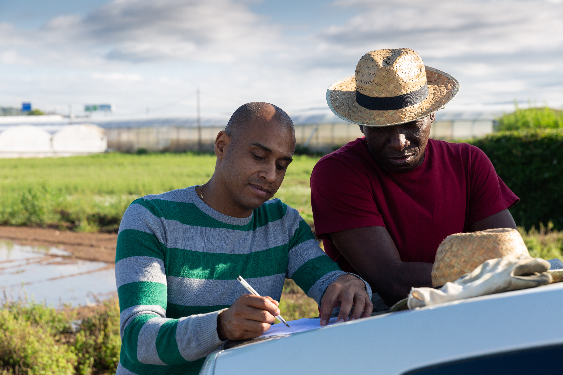
Step 4:
Communicate Expectations on Living Income and Engage Suppliers

Slide 20
Integrating Living Income into your Strategy & Developing Key Performance Indicators
Company Example: MARS Income Position Statement
“At Mars, we believe everyone working within our extended supply chains should earn sufficient income to maintain a decent standard of living.
We must play our role, alongside the other critical actors including governments, suppliers, supply chain partners and the farmers themselves, in achieving this ambition.
In the long-run, our vision is for business to be built on high-quality and highly-efficient supply chains where people are thriving, engaged and motivated, and where all parties earn a decent standard of living. This ambition applies to everyone in our supply chain, but our first priorities are those within our operations and those who are most vulnerable: farmers and farm workers. Within our operations we continue to monitor compensation for our 85,000 Associates.”
Notes:
https://www.mars.com/about/policies-and-practices/farmer-income

Slide 21
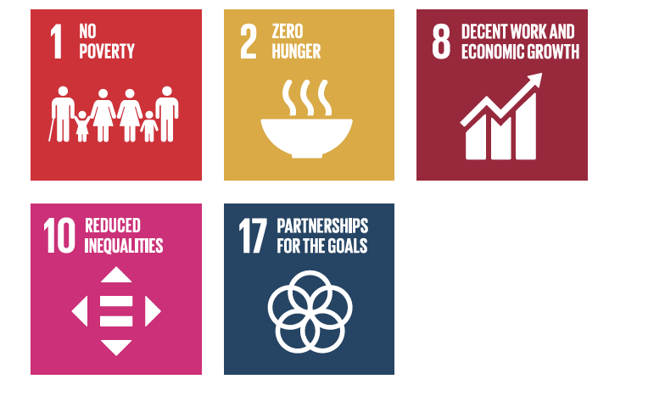
Living Income and the SDGs
Connecting to SDGs
The business strategy on living incomes should be formulated in line with inclusive business principles. It should state that the company prioritises the inclusion of smallholder farmers in its supply chain and is committed to a pathway towards a living income for those farmers. Commitments to the following SDGs can support the principle of inclusion:
Notes:
The Living Income Story, as illustrated above, shows the basic building blocks of a living income.

Slide 22






Living Income in Your Industry
Vanilla
Sustainable Vanilla Initiative
Tea
Ethical Tea Partnership
Malawi 2020
Tobacco
Sustainable Tobacco Partnership
Cross Sector Initiatives
INA (Initiative for Sustainable
Agricultural Supply Chains)
Cocoa
World Cocoa Foundation
International Cocoa Initiative
Swiss Platform for Sustainable Cocoa
Beyond Chocolate (Belgium)
German Initiative on Sustainable Cocoa
Dutch Initiative on Sustainable Cocoa
Coffee
Task Force for Coffee Living Income
ICO Public Private Task Force
Notes:
The Living Income Story, as illustrated above, shows the basic building blocks of a living income.

Slide 23

Step 5.1:
Define Living Income Benchmarks

Slide 24
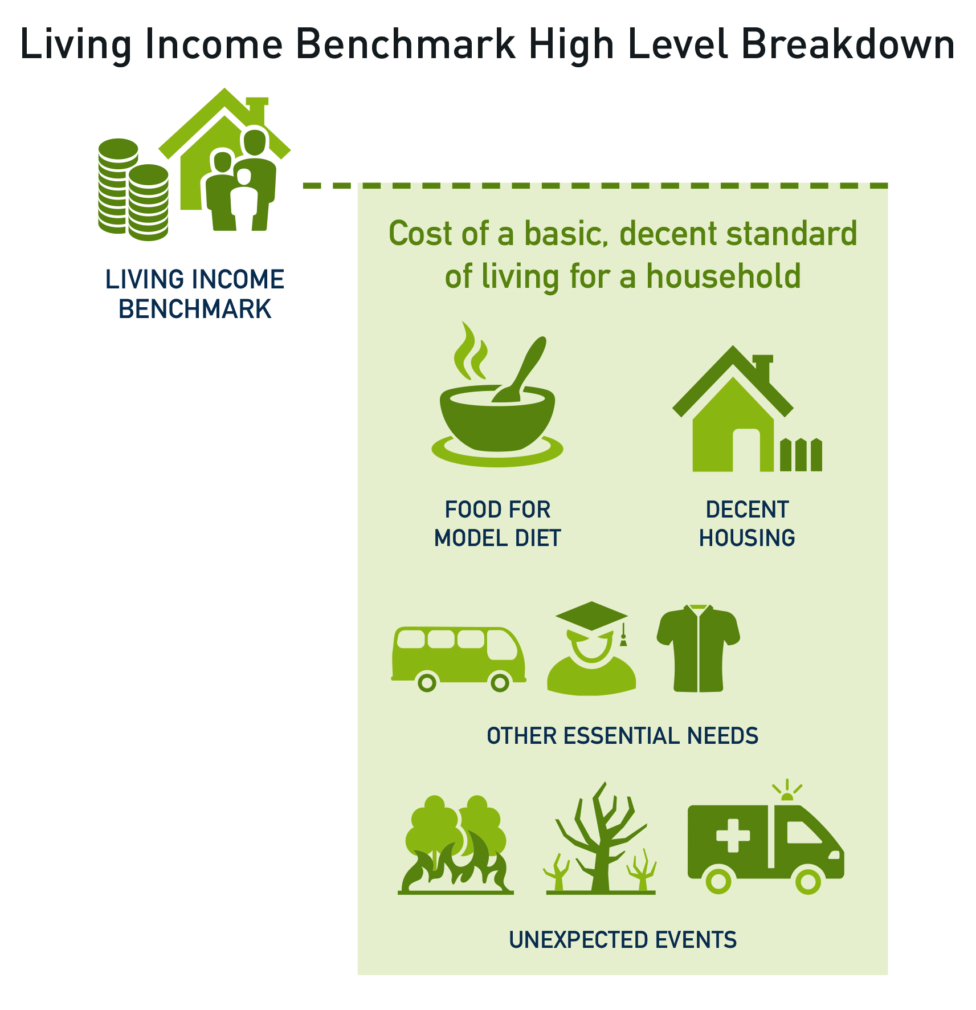
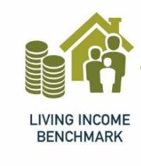
What is a Living Income Benchmark?
A living income benchmark is an estimate of the cost of a basic and decent standard of living for a household.
It answers the question: ‘how much does a typical household in a particular place need to earn, from all income sources, in order to live a decent standard of living?

Slide 25
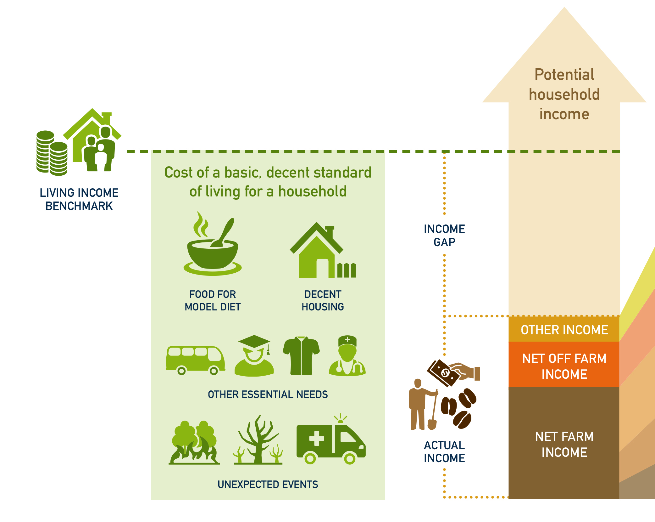
What Is An ‘Income Gap’, and How Does It Relate to the Living Income Benchmark?
An income gap is the difference between the living income benchmark and current income of a typical farming household.
Learn more about calculating and visualizing the income gap to a Living Income Benchmark here and download this excel tool for gap visualization here.
Notes:
https://c69aa8ac-6965-42b2-abb7-0f0b86c23d2e.filesusr.com/ugd/0c5ab3_74a43f3647724bc58caf4daaa570482b.pdf
https://drive.google.com/drive/folders/10f3vP7j2WFgNKm1t1s4PrwzpSwCHSlzn

Slide 26
How Can I Use a Living Income Benchmark?
  Raise awareness about income needs of farming households
  How much do farming families need to earn to enable a decent standard of living?
  Is getting out of poverty enough?
  Provide a goal for strategies and collective efforts to raise farmer incomes
  All farming households should be earning a living income
  Understand the income gap
  How far are current farmer incomes away from earning a living income?
  How much more would the average farming household need to earn a living income?
  Inform intervention strategies
  How much would a price increase or productivity gain reduce the gap?
  Inform the calculation of other normative benchmarks
  What price should buyers pay (e.g. living income reference price)?

Slide 27
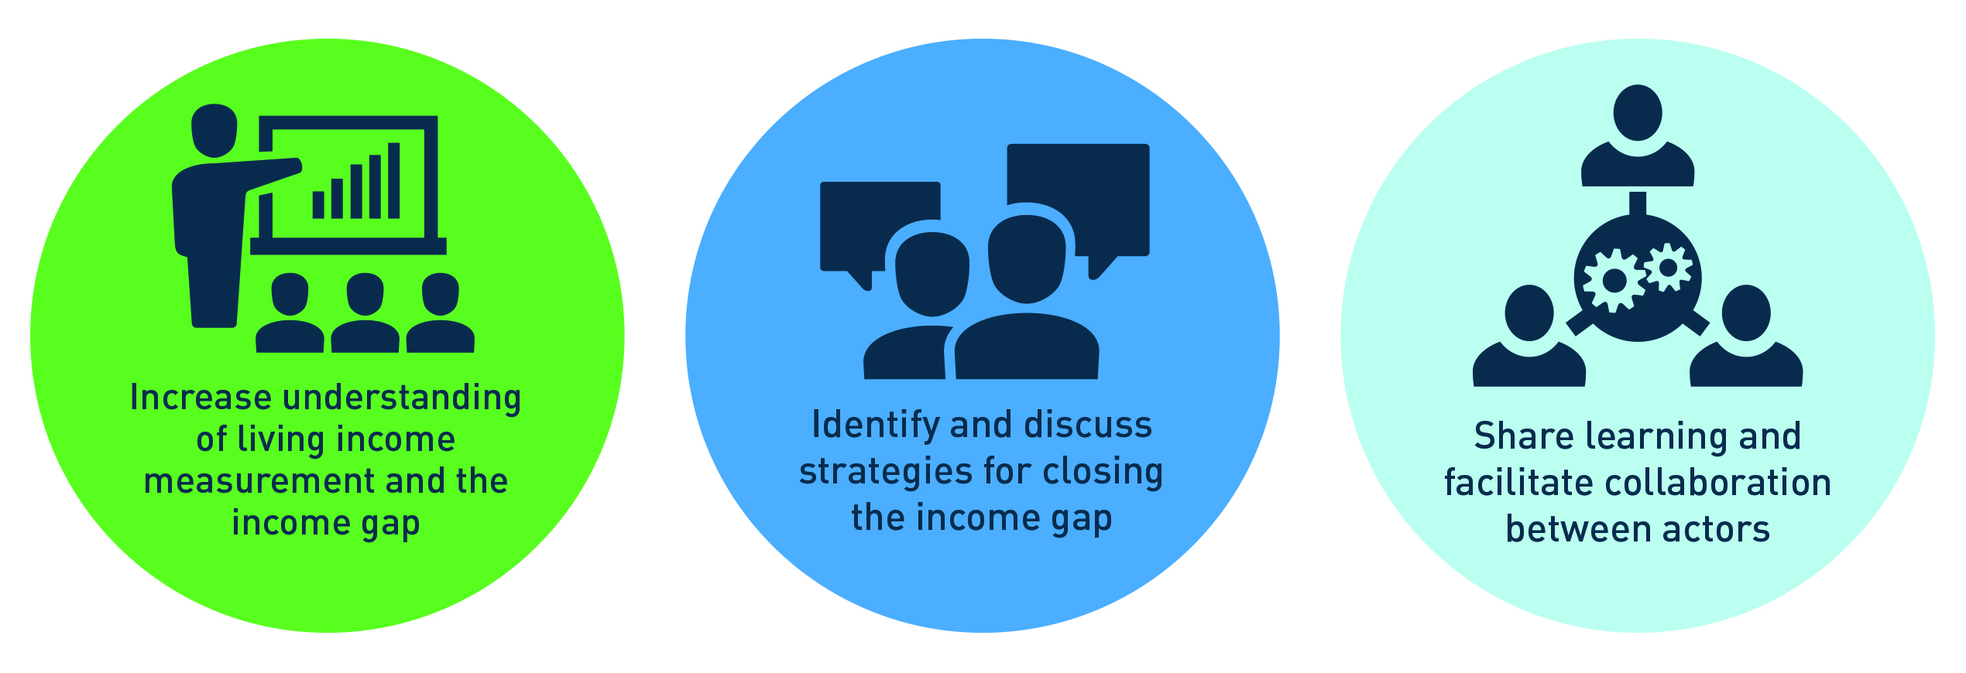
Understanding Living Income and the Income Gap
should help inform and support action. Lack of a living income benchmark should not hold up action.
We recommend that you ask yourself key questions – in three steps - before deciding which alternative(s) would make sense in your case.
See following slides.

Slide 28

Where do I start?
1
Look for an Anker Living Income Benchmark in your region or country.
2
If a Living Income Benchmark does not exist, look for an Anker Living Wage Benchmark you can adapt.
3
If neither exist,
examine what alternatives exist.

Slide 29



Where Can I Go to Look for Living Income Benchmarks?
Visit the following locations:
www.living-income.com/living-income-benchmarks
www.globallivingwage.org
www.align-tool.com
www.living-income.com/reports
GIZ has compiled all available Living Wage & Living income benchmarks into one ease to read document.
Living wage estimates available in 26 countries, with application in multiple industries.
Website with ambition to eventually host information on all available living income and living wage benchmarks.
Living income benchmarks available for the cocoa industry in Ghana & Cote d’Iviore.
Notes:
Living Income Community of Practice:
Living Income/Living Wage document (includes all available benchmarks): www.living-income.com/living-income-benchmarks
Ghana Benchmark: https://docs.wixstatic.com/ugd/0c5ab3_55017cee608047d494f56b496925ae4a.pdf
Ghana Benchmark Update: https://c69aa8ac-6965-42b2-abb7-0f0b86c23d2e.filesusr.com/ugd/0c5ab3_8b6a7e26d7c04908a7738f1c97376a78.pdf
CDI LI Benchmark: https://docs.wixstatic.com/ugd/0c5ab3_71310ed04c5d4fec8805580ed901c933.pdf
Global Living Wage Coalition: https://www.globallivingwage.org
ALIGN Tool https://align-tool.com/about
Other Resources:
https://app.smartsheet.com/b/publish?EQBCT=cf8dfa211d3a44a49a1392465140e5a4
https://www.living-income.com/existing-information

Slide 30
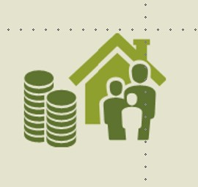


How Can I Derive a Living Income Estimate From a Living Wage Report?
Cost of decent standard of living for family
First, understand the relationship between living wage and living income, according to the Anker methodology endorsed by the Global Living Wage Coalition.
Living wage
=
+
Number of workers per family
Payroll deductions and taxes
Adapted from Richard Anker and Martha Anker (2019)

Slide 31
If I Don’t Find a Living Income or Living Wage Benchmark, Is There an Alternative?
Living Income/Living Wage benchmarks for your area of interest
Urban/rural living income estimates (e.g. Anker reference values)
A Living Income Benchmarks using the Anker Methodology
are the most robust source of information due to the geographic specificity and ability to capture all relevant Living Income data such as locally verified costs of food and housing. Anker Benchmarks are the gold standard.
Geographic Specificity
HEA Survival Thresholds
National poverty lines
World Bank poverty line
Living Income Relevance

Slide 32
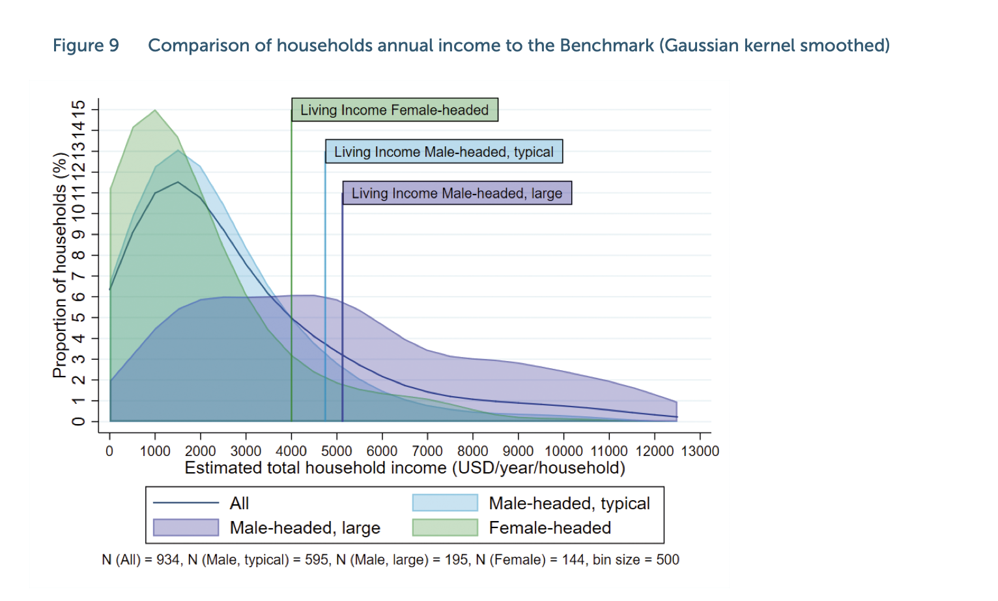
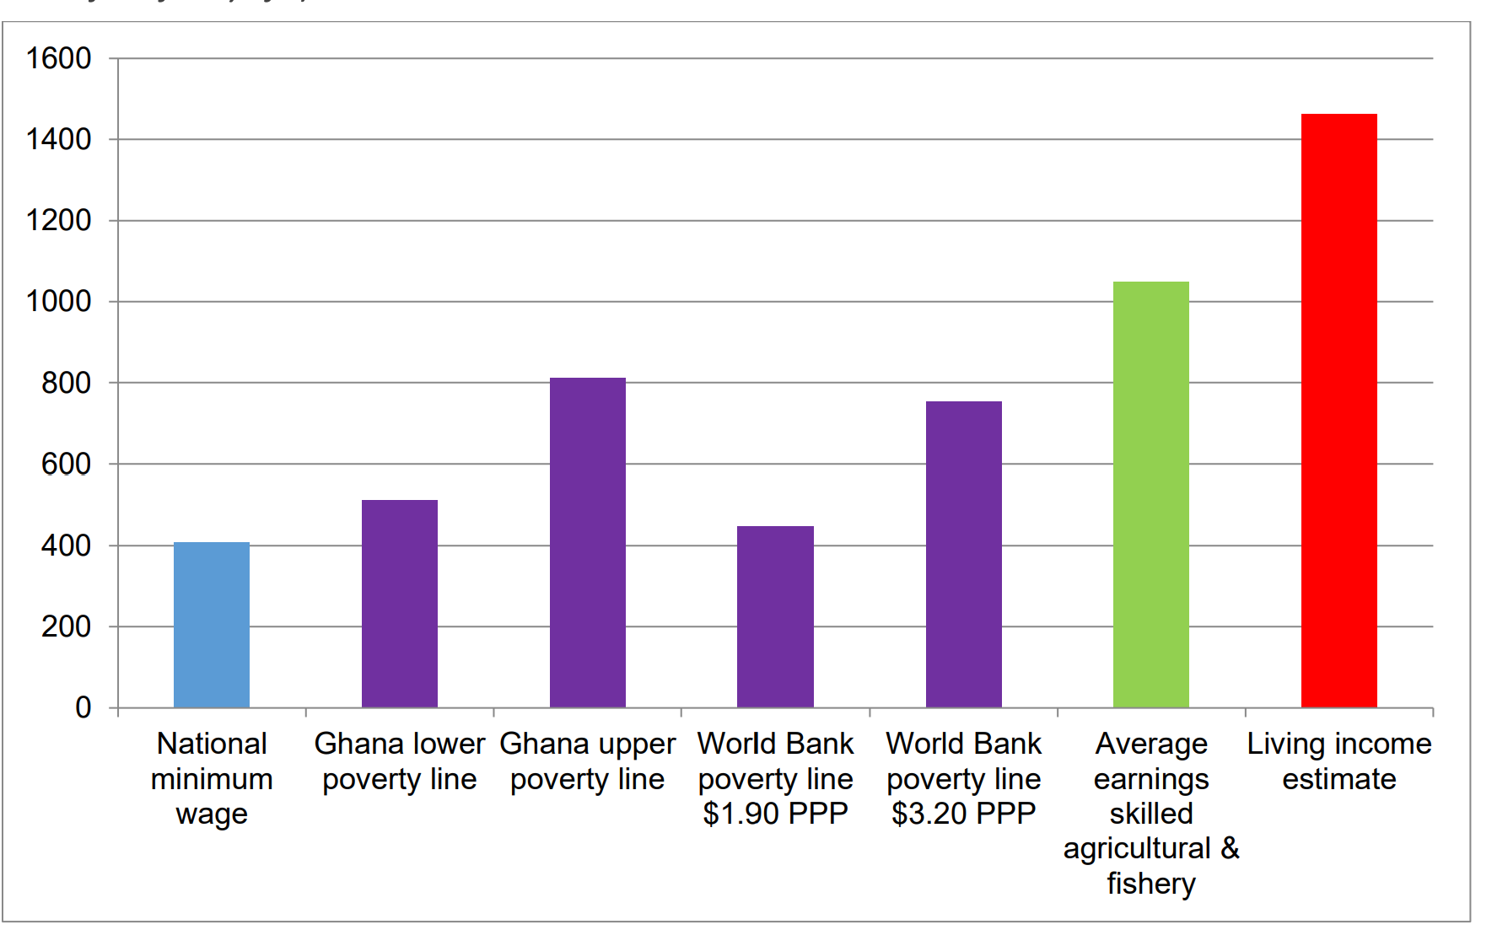
What is the Difference
Between a Poverty Line and a Living Income
Benchmark?
Poverty lines are generally lower than living income estimates, though this could vary depending on methodologies used for poverty estimation. In general, poverty lines focus on basic needs baskets while living income estimates are about a basic but decent standard of living.
An income ladder is a good way to visualize the various benchmarks for a particular location. This example is from Sally Smith with Daniel Sarpong, Living Income Benchmark Report: Ghana, 2018.
Notes:
https://c69aa8ac-6965-42b2-abb7-0f0b86c23d2e.filesusr.com/ugd/0c5ab3_93560a9b816d40c3a28daaa686e972a5.pdf

Slide 33

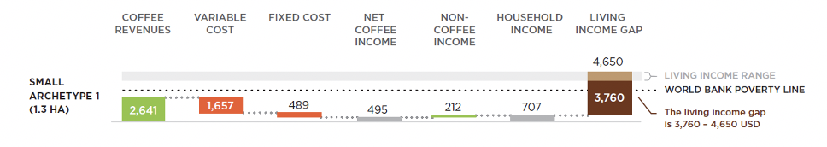
Do I Have to Choose Just One Income Benchmark?
No, here’s an example with a visualization of both the WB Poverty Line and a living income benchmark
Source: Task Force Coffee Living Income
Report: https://www.idhsustainabletrade.com/uploaded/2020/02/Coffee-TF-2020-9.8-small_final1-executive-summary.pdf

Slide 34
How Important is it to Know Exactly What a Living Income is in Your Area of Interest?
What do you know about farmers’ incomes? | I expect that most farmers in my area of interest are already above the poverty line. | I know I am working in a high poverty area. | I don’t know much about household incomes in my area of interest.
An estimate of living income will add a lot of value in helping shape strategy and monitor progress.
Monitoring progress towards closing the poverty gap will be a meaningful step towards living income.
Understanding poverty status of households would be a meaningful first step.

Slide 35
How Can I Find Others Who Want to Collaborate on a Benchmark Study?
Multiple members of the Living Income Community of Practice are working on benchmarks. We highly recommend collaborate work to develop transparent, credible and public benchmarks.
Please email livingincome@isealalliance.org with your countries and crops of interest.
We will connect you with partners and/or offer support on understanding the timeline for forthcoming benchmarks.

Slide 36
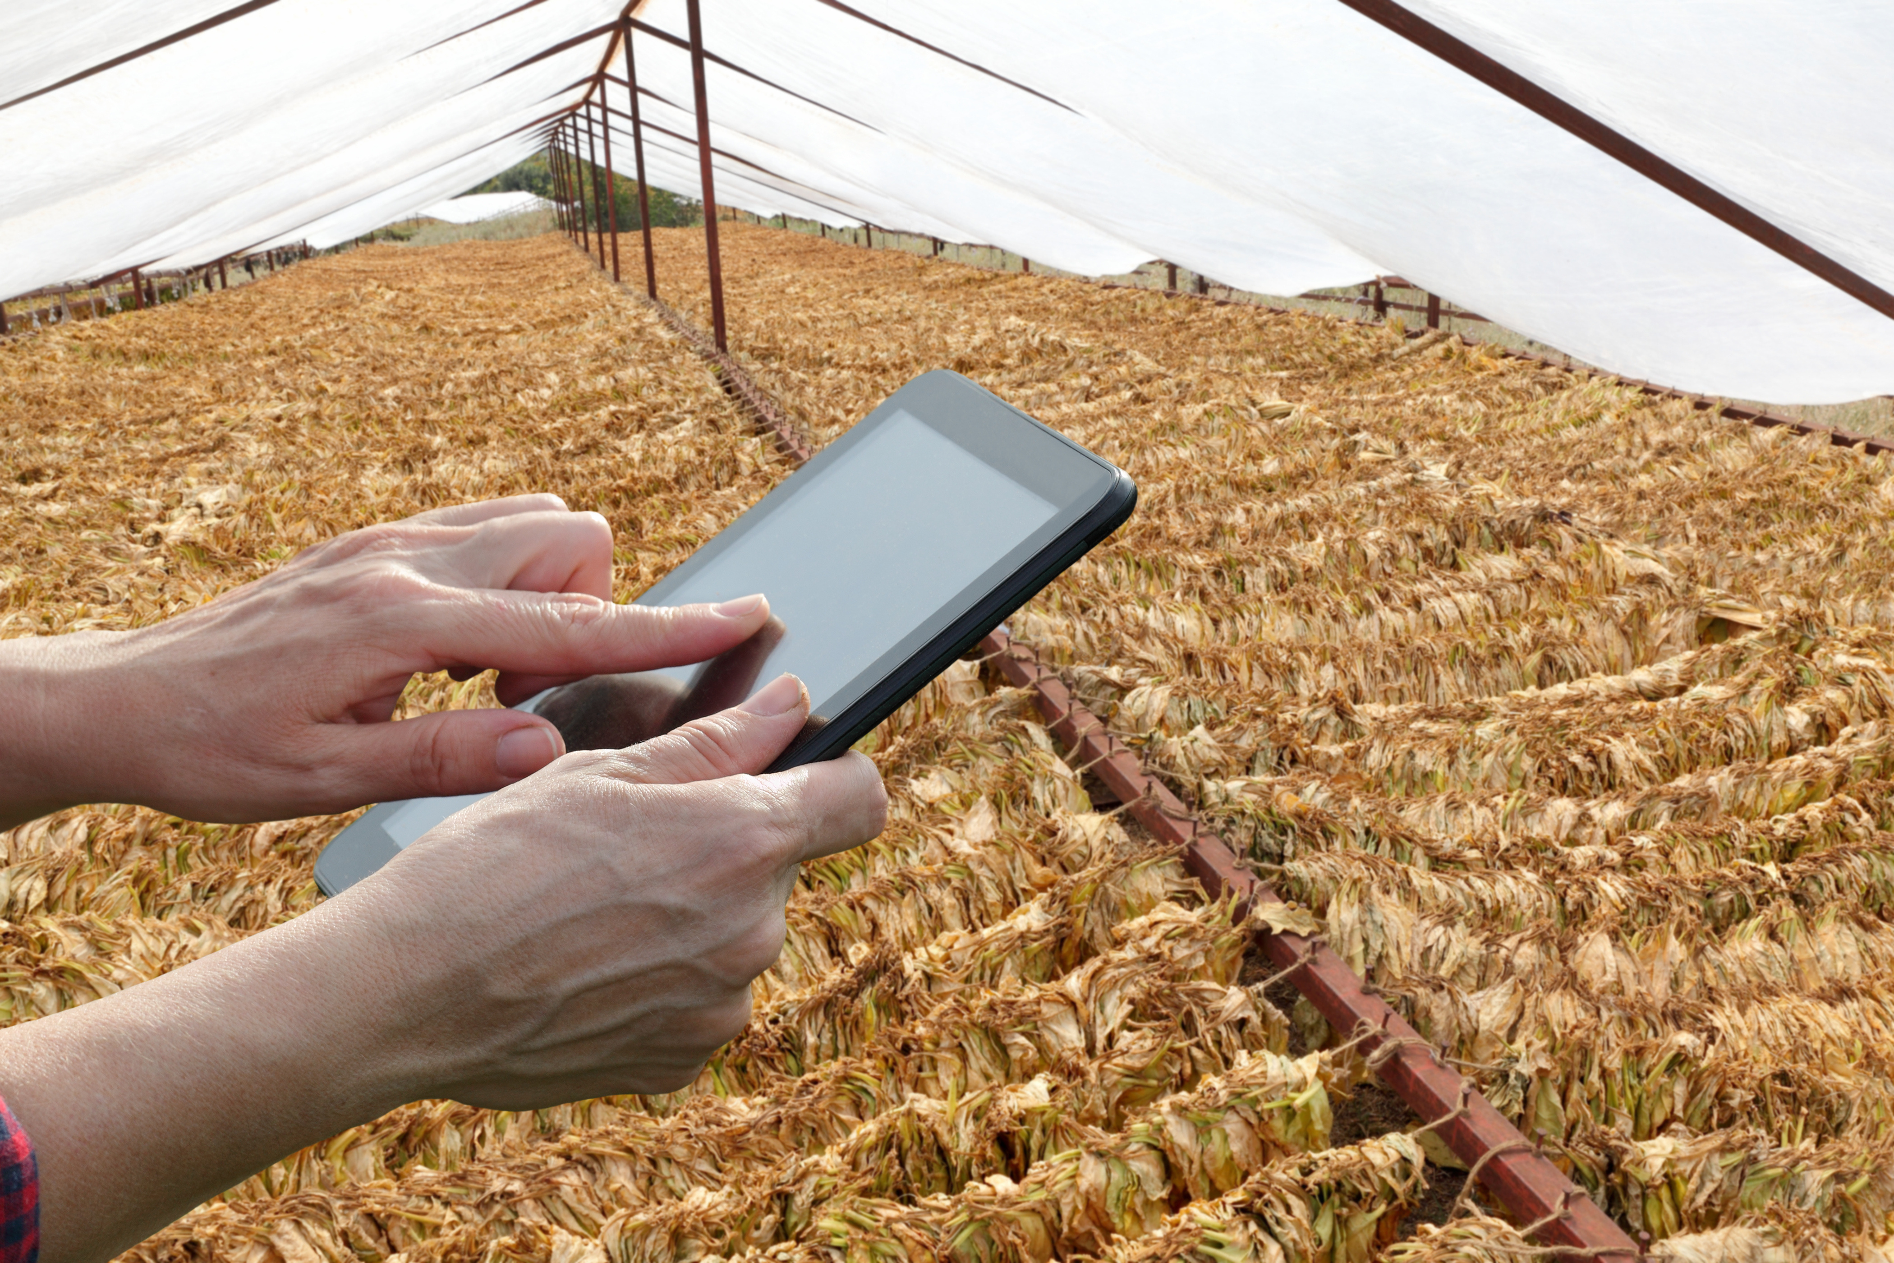
Step 5.2:
Determine actual incomes and measure gaps

Slide 37
Measuring Actual Incomes
With a living income benchmark in place, buyers can evaluate the actual income of farm households.
Actual income is the total net household income and can be established using a number of methods
Farmer self-reported income data
Farmer surveys can be used to understand the amount of income from cash crops, other crops and livestock, off-farm income, other sources of income (such as wage work or remittances) and the value of food produced at home (as this can reduce the cost of food for a family). There are varying degrees of data quality from farmer recall, as it is difficult for any individual to recall specific revenue and costs.
Calculated incomes from existing records
Cooperative or aggregator records can be a source of commercial data such as yields, farm size and farmgate price. Some organisations also track costs of production and % total household income from target crops. With these data variables, household incomes can be estimated.
A review of farm records can be extremely helpful for understanding the actual costs of production in a farm’s main crop and potentially their secondary crops. However, for smallholders in regions with high illiteracy and poverty rates, farm records are rarely kept and would require a technical support programme. Research studies can provide a credible, third party analysis of typical incomes in a region. If using third party research studies, care must be taken to understand the extent to which the results represent the farmers in your sourcing regions, how large the sample was and the methods used to collect income data.
Impact assessments done in your supply chains and sustainability programmes can yield the best quality data on farmer incomes.

Slide 38
Creating a Farmer Survey
When establishing a living income benchmark or measuring actual household incomes, it is important to engage with institutions and initiatives that have been developing and testing methodologies both to calculate living income benchmarks and to identify actual incomes. Incomes and other financial data are always sensitive information to ask farmers to report.
Credible reporting requires both skill on the part of the enumerator as well as a level of trust between the interviewer and interviewee. Best practices in the field of poverty research are recommended to avoid common pitfalls which can lead to inaccurate or faulty data quality.
Some examples are:
• The Living Income Community of Practice has developed several guidance documents
• The Poverty Action Lab provides an extensive Introduction to Measurement and Indicators
• The World Bank has Lessons from 15 Years of the Living Standards Measurement Study

Slide 39

Understanding the Gap
Benchmarks are used with data on actual income to understand “the gap”
Cost of a “decent” life, including cost of a full diet. This is independent of the income strategy.
Living Income
Benchmark
GAP
Actual net income, including value of food produced for household consumption
Actual
Household
Income

Slide 40
Family Household Income Varies
Income within a supply chain can vary drastically due to many factors (farm size, productivity, food produced at home and other income sources to name a few), meaning the gap to a living income can vary as well.
Notes:
https://c69aa8ac-6965-42b2-abb7-0f0b86c23d2e.filesusr.com/ugd/0c5ab3_93560a9b816d40c3a28daaa686e972a5.pdf

Slide 41
Modeling Ways to Close the Income Gap
Cocoa renovation example from Cote d’Ivoire
Income per day per HH member (CFA)
Living Income Benchmark $2.1/p/d
Scenario 1
Assumptions
4ha cocoa, trees 30 years old
Base price - FT min price. Includes cost share on replanting
Poverty line .9/p/d
Scenario 2
Scenario 1: replants 2 Ha (5 year gap), crop protection on 2 ha. With Flexible Premium (900)
Baseline
Scenario 2: GAP + crop protection only (trees not fertilizer responsive)
Poverty line is based on World Bank study local PPP equivalent of 1.90/p/d
Baseline: status quo, no investment
Source: SFL model based on Cote d’Ivoire data, 2016
Notes:
https://c69aa8ac-6965-42b2-abb7-0f0b86c23d2e.filesusr.com/ugd/0c5ab3_93560a9b816d40c3a28daaa686e972a5.pdf

